Slide 1
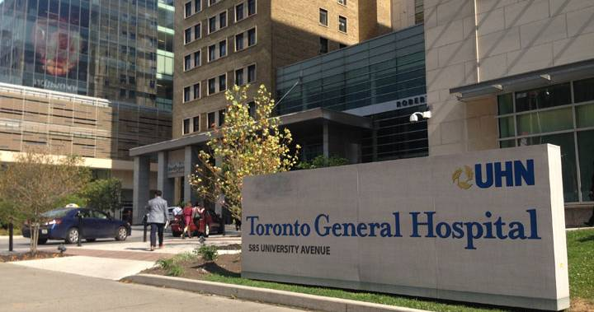


Ahmad S. Omran MD, FACC, FESC, FASE
Cardiology Consultant
Department of Anesthesia and Pain Management
Toronto General Hospital- UHN
University of Toronto

Slide 2
Tricuspid and Pulmonic Valves:
Anatomy, Imaging, and Pathology
Aug 7, 2019
Department of Anesthesia and Pain Management- TGH, Toronto

Slide 3
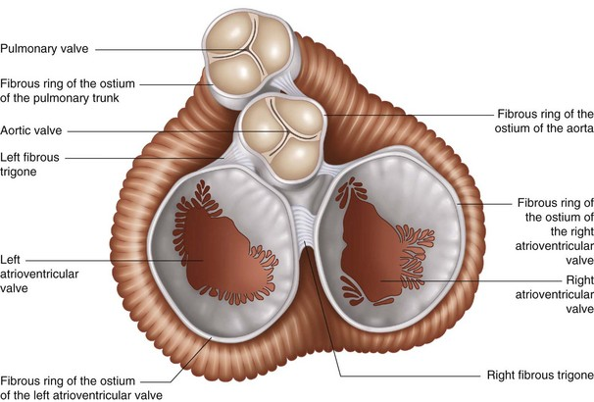
Fibrous skeleton of the heart (cardiac skeleton)

Slide 4
Tricuspid Valve: The Forgotten Valve

Slide 5
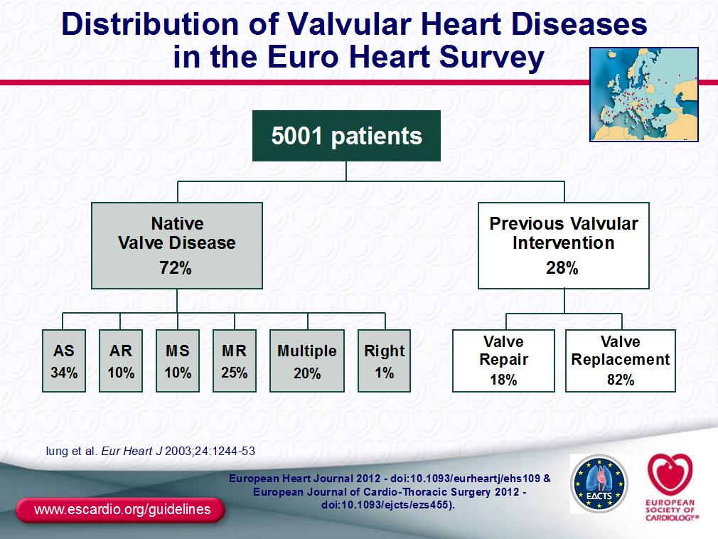

Slide 6
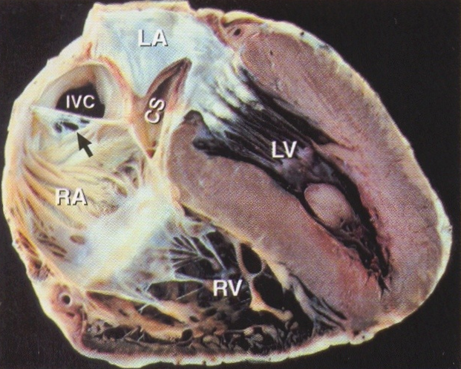
Anatomy of TV and RV

Slide 7
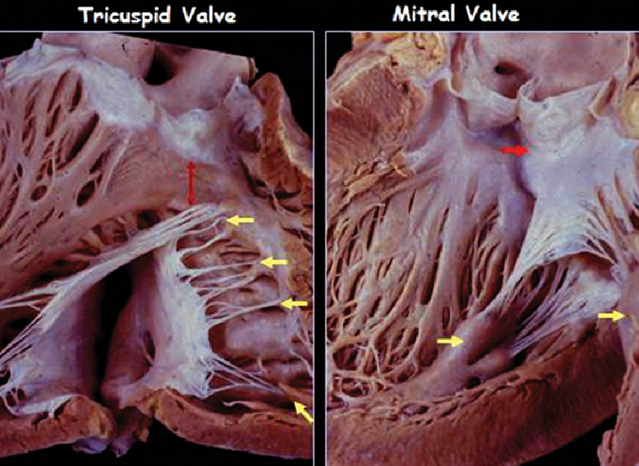
Comparison between anatomy of the MV and TV. MV is in continuity with AoV while TV is not in continuity with PV. Both papillary muscles are attached to both MV leaflets while in right side, each TV leaflet can be attached to a single papillary muscle or two of them.

Slide 8
JACC Imaging, March 2019
JACC Imaging, March 2019

Slide 16
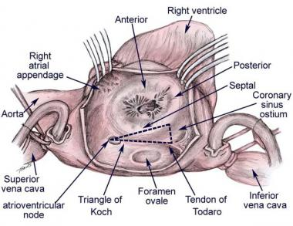
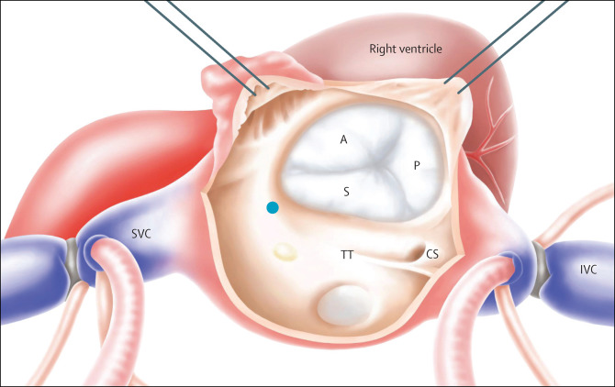
Note: Triangle of the Koch is an important landmark for ablation of the slow pathway in atrioventricular nodal reentrant tachycardia (AVNRT).
Crista terminalis is the landmark during SN ablation
Crista terminalis
Surgical view of the tricuspid valve and right atrium

Slide 17
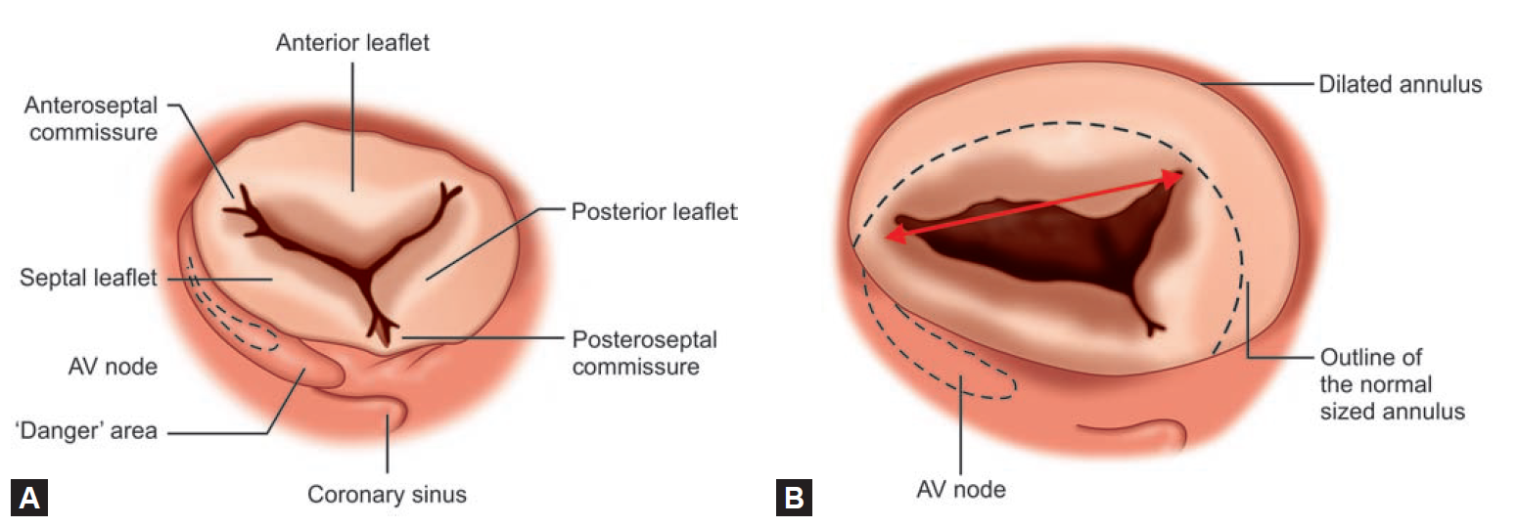
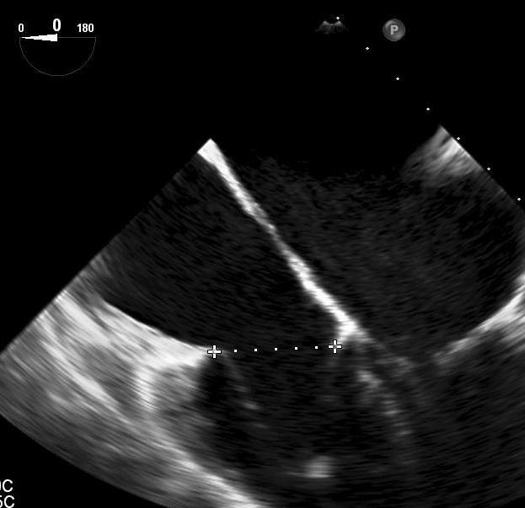
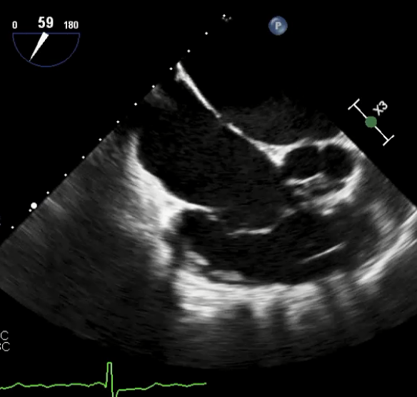
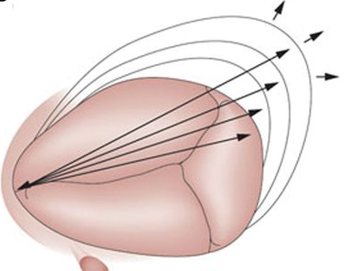
???
???
A
4.2 cm
P
2.8 cm
S

Slide 18
How to image the tricuspid valve?

Slide 20
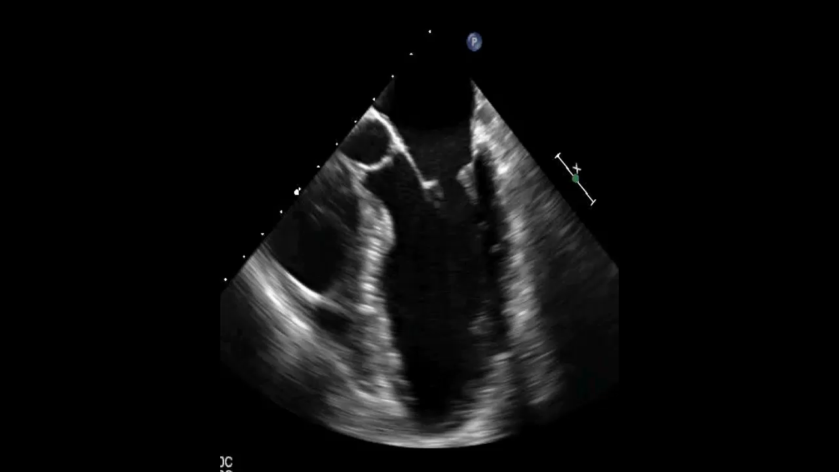
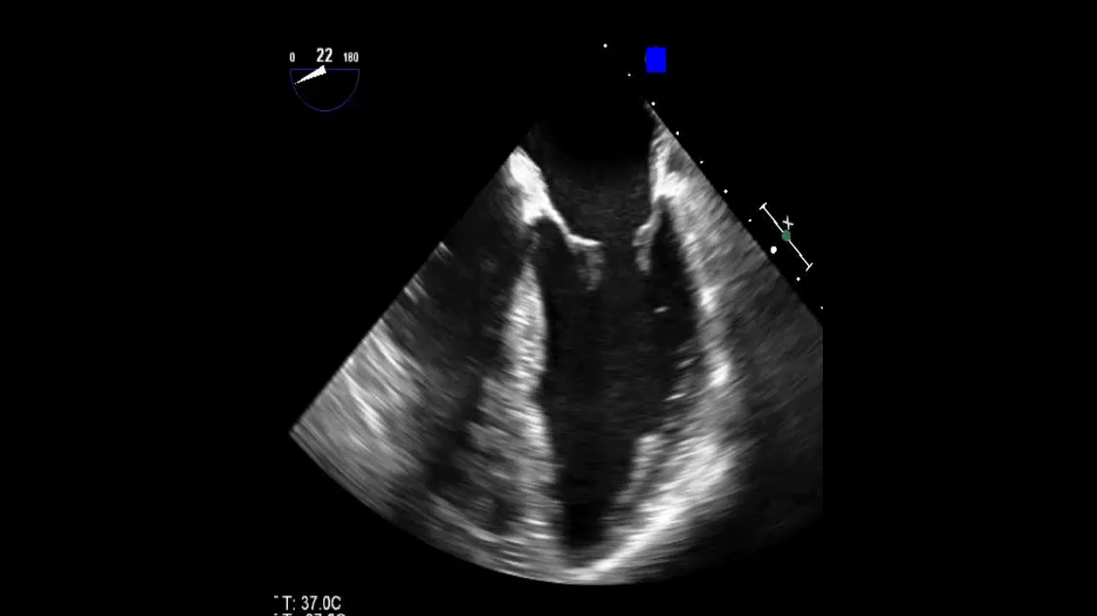
LA
LA
RA
RA
AoV
RV
RV
LV
LV
1- ME 5-Chamber View
2- ME 4-Chamber View

Slide 22
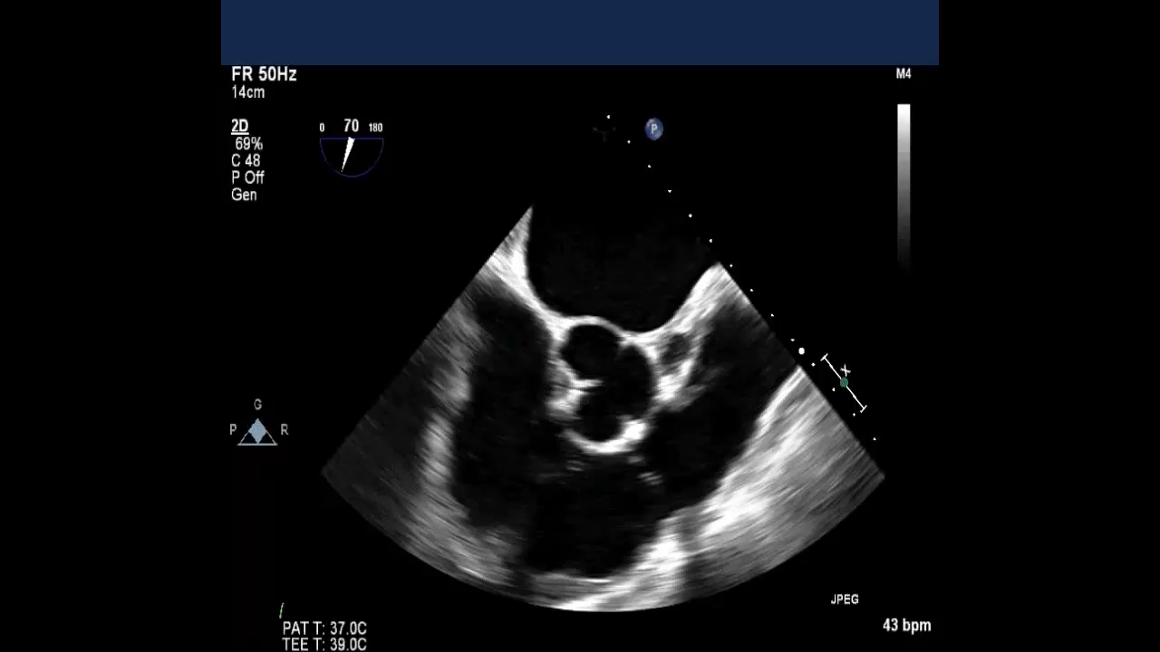
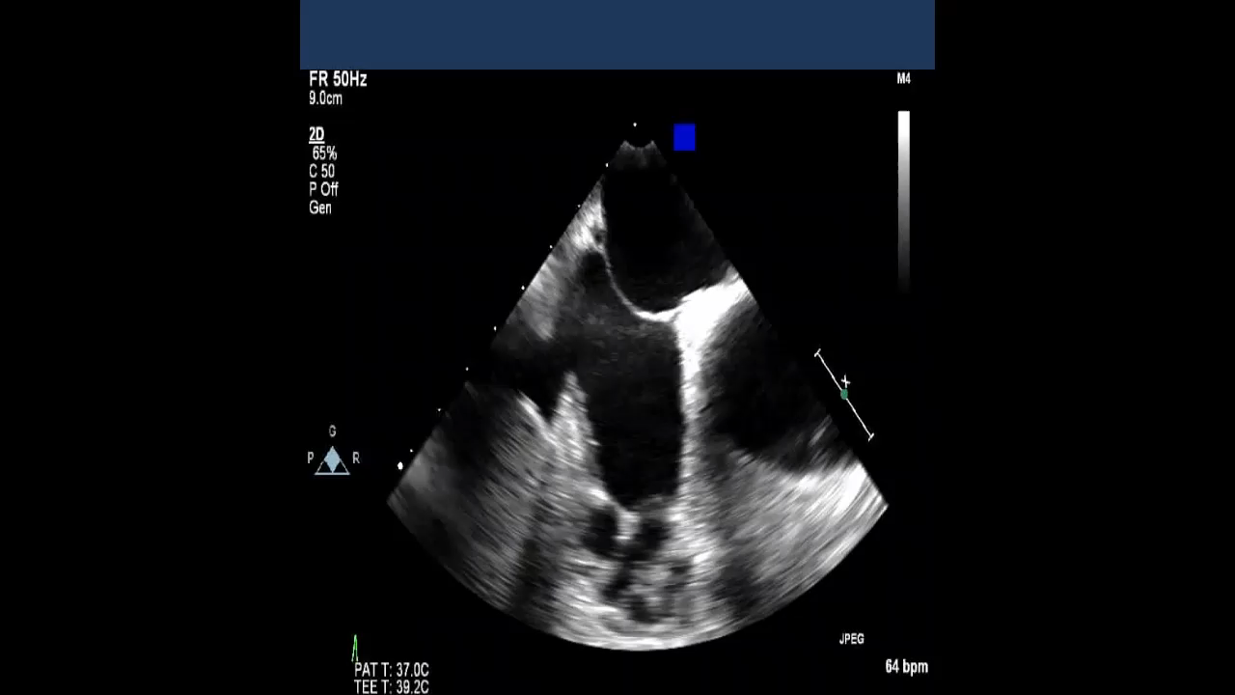
RA
RA
RA
TV
TV
RVOT
11- ME RV Inflow-Outflow View
12- ME Modified Bicaval TV View

Slide 24
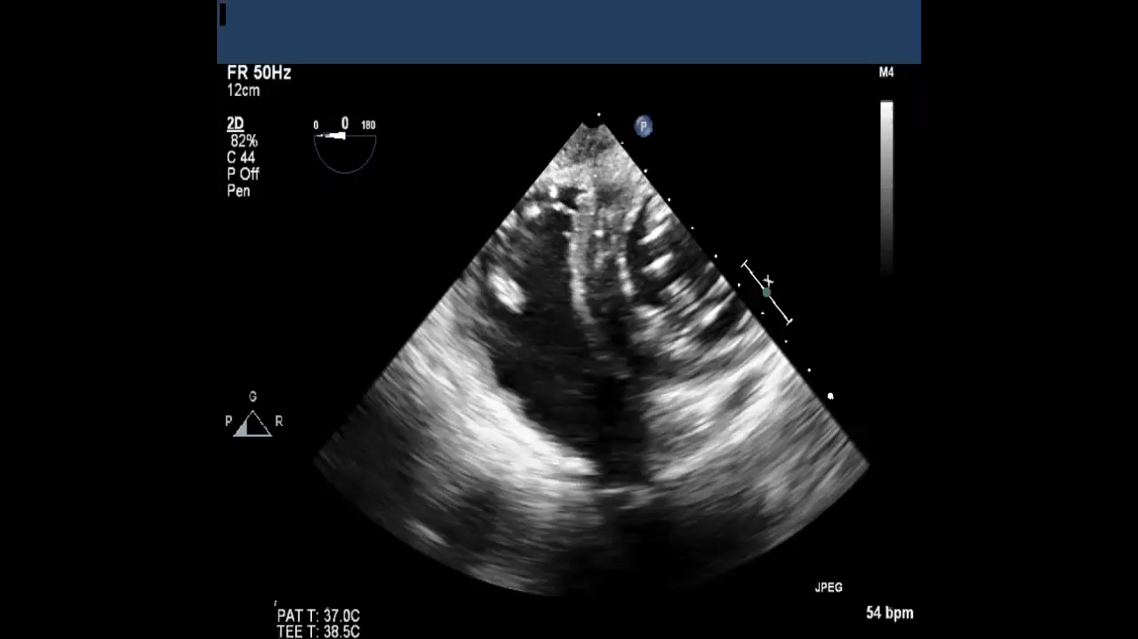
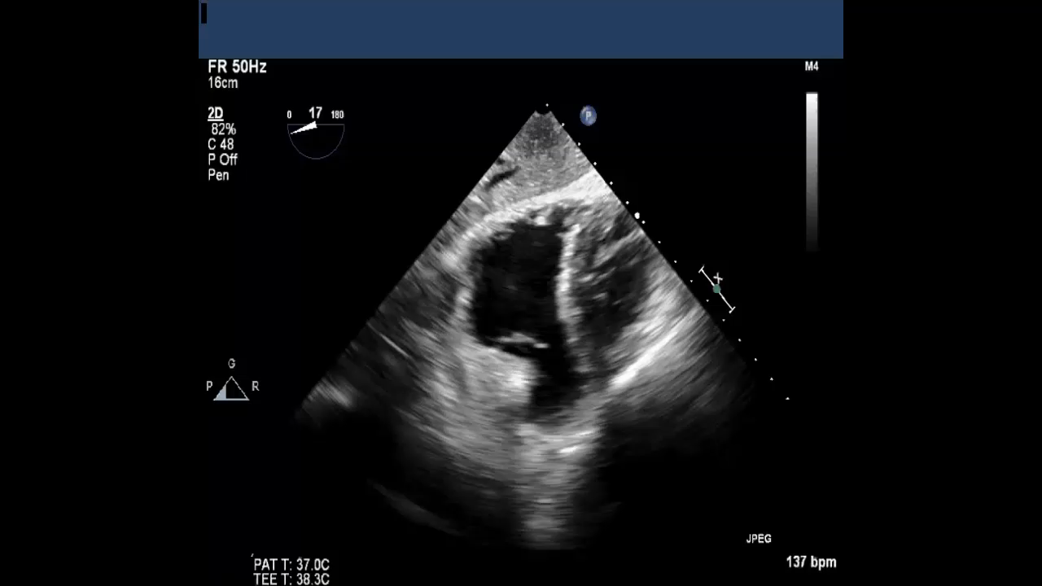
RV
TV
RA
RVOT
RVOT
19- TG RV Basal View
20- TG RV Inflow-Outflow View

Slide 26
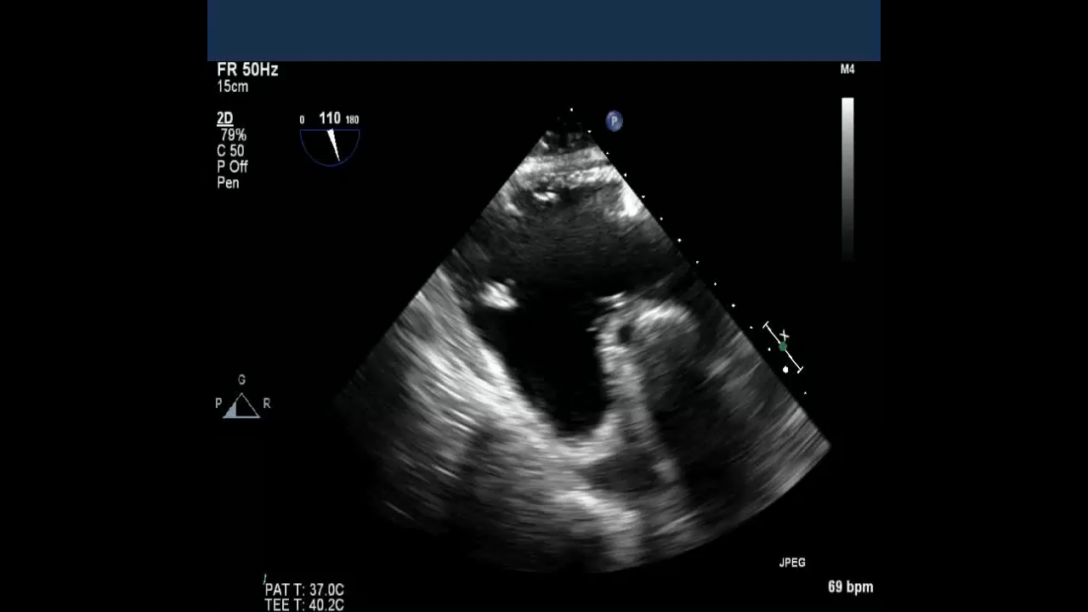
PTVL
RV
RA
RV
ATVL
23- TG RV Inflow View

Slide 27
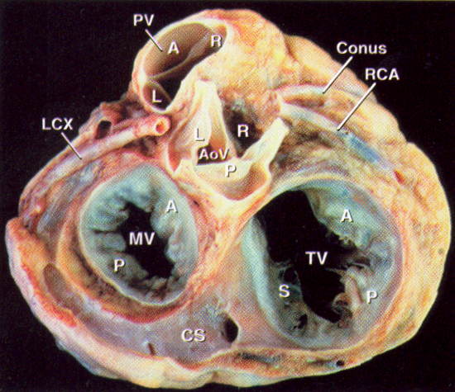
Base of the heart with atria removed, looking from posterior to anterior, showing four cardiac valves

Slide 28
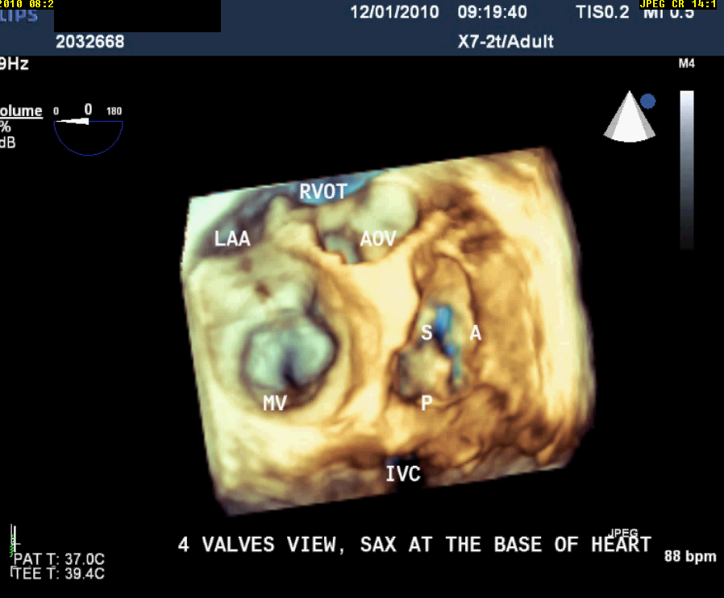

Slide 29
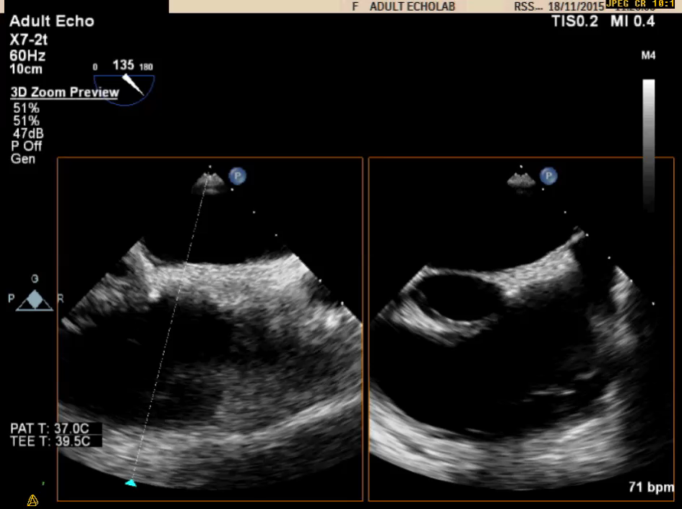
TEE imaging of the TV, 3D zoom mode

Slide 30
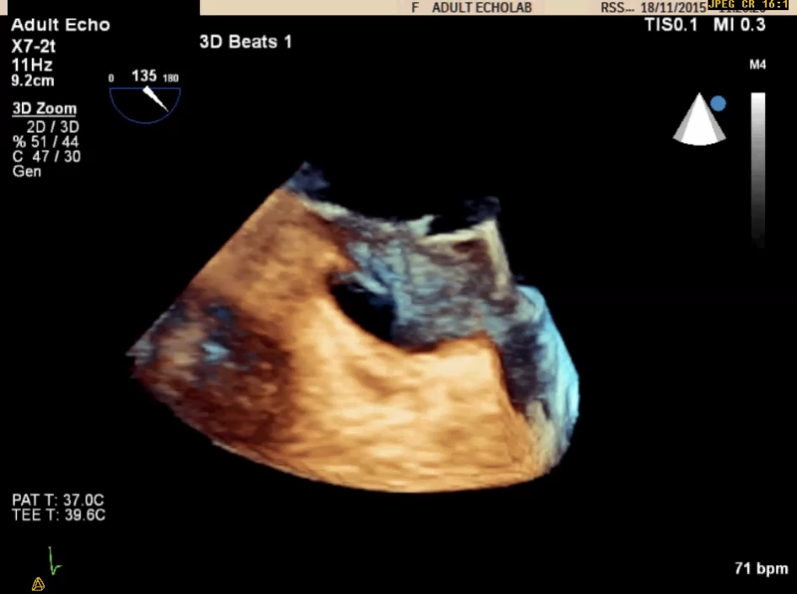
IAS
Aorta

Slide 31
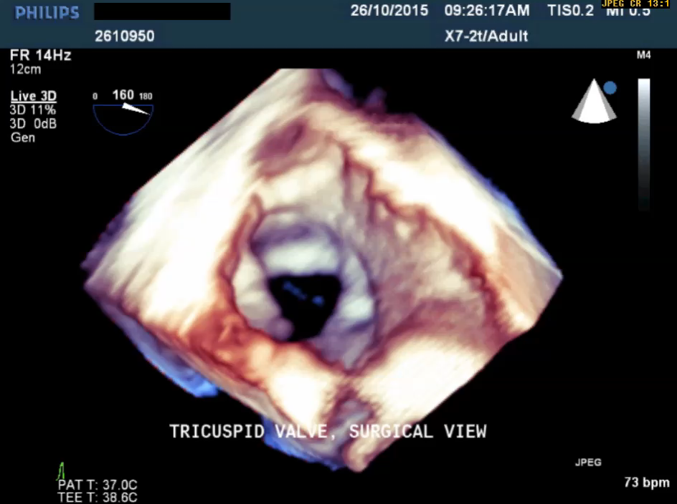
Surgeon’s view

Slide 32
RAA
ATL
SVC
STL
PTL
Aorta
IVC
CS
MV

Slide 33
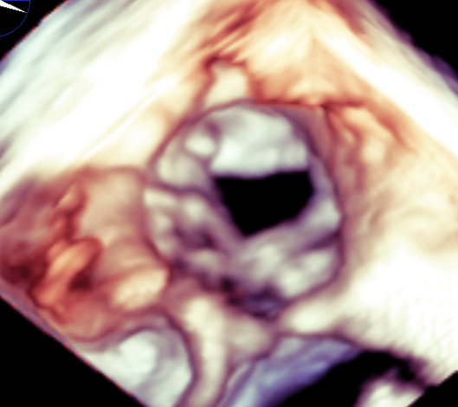
ATL
PTL
STL
Surgical view of the TV

Slide 34
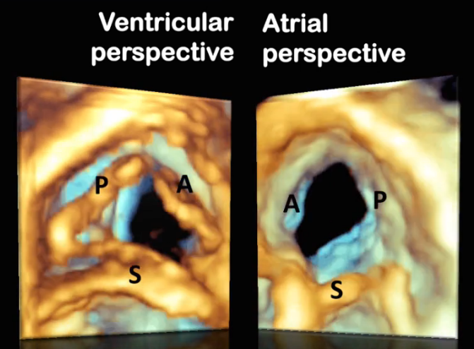
3D TTE of the tricuspid valve
R. Lang, Chicago

Slide 35
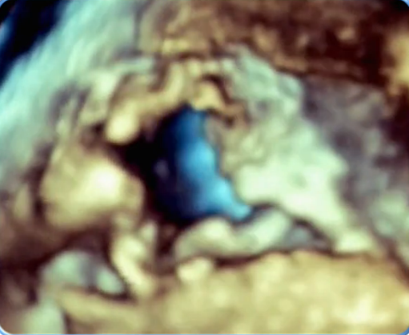
How many cups TV can have? TV with 4 cups from RV side

Slide 36
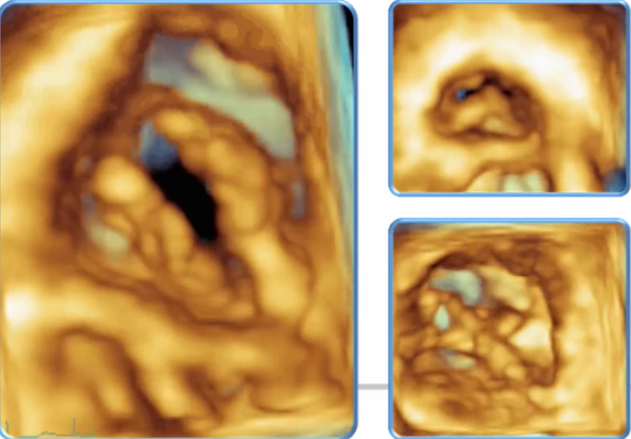
From RV side
TV with 2 cups and small PTL (ITL)

Slide 37
Tricuspid stenosis (TS)

Slide 38
Etiology of tricuspid valve stenosis (TS)
TS is the least common valvular lesion
1. Rheumatic (associated with MV, rarely isolated)
2. Congenital malformation
3. Carcinoid disease
4. Lupus valvulitis
5. Masses obstructing flow (i.e. myxoma, metastasis,
thrombus)
6. Device lead impairing valve function (i.e. pacemaker)
7. Drug related valvulitis

Slide 39
2009 ASE guideline

Slide 42
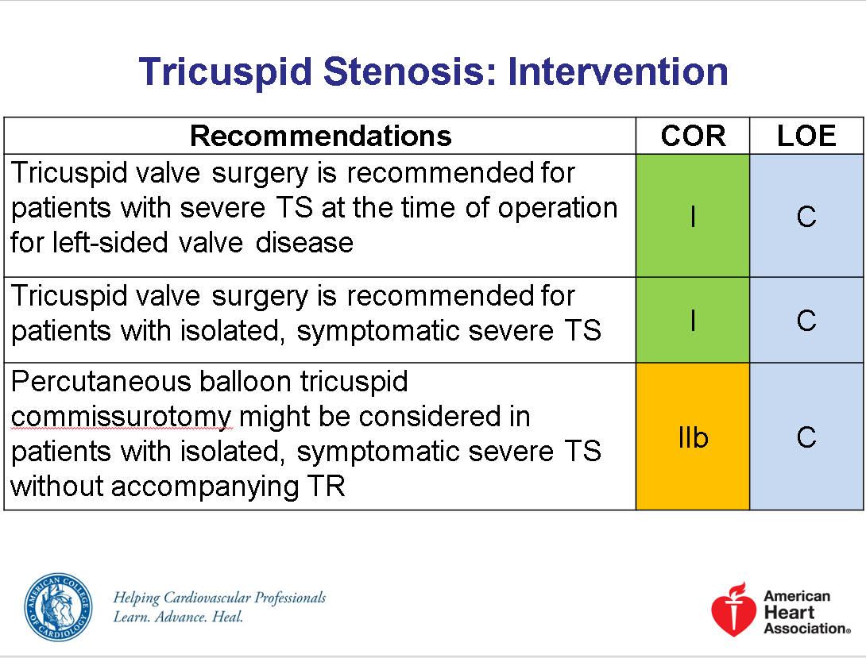
Severe TS: PHT ≥ 190 ms, TVA ≤ 1cm2
Mean gradient ≥ 5 mmHg
2017 ACC/ AHA guideline

Slide 43
Case 1
17-year-old boy presented with fatigue and mild cyanosis

Slide 44
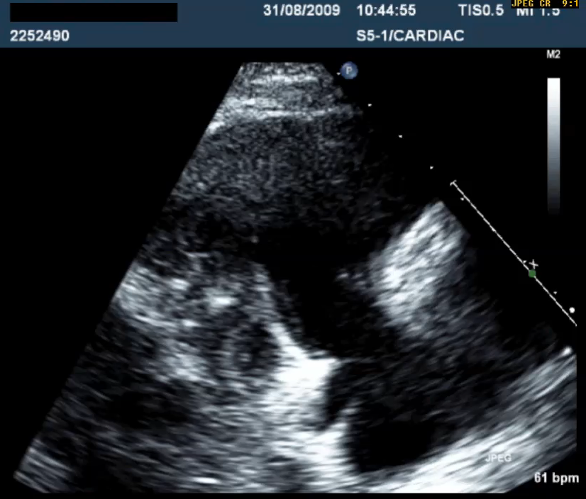
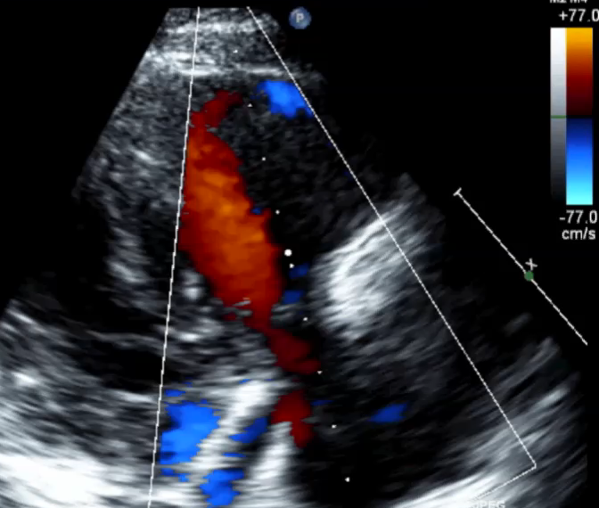

Slide 45
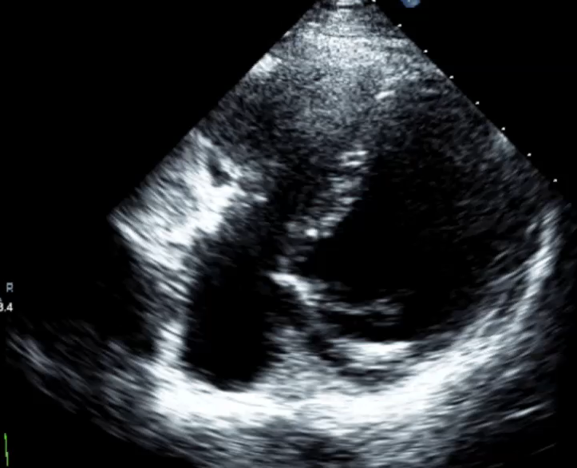
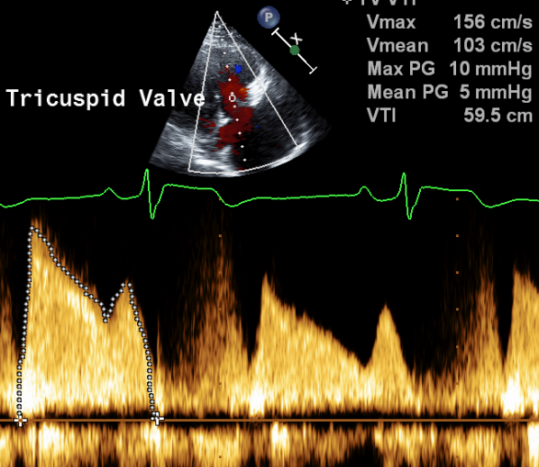
Diastolic doming of the TV leaflets, mean gradient = 5 mmHg

Slide 46
Dr. Najm, KACC, Aug 2009

Slide 47
Tricuspid regurgitation (TR)

Slide 48
Etiology of tricuspid regurgitation (TR)
Nearly 60% of young adults have mild physiologic TR. Etiology of Primary (organic or structural) TR (10% of all TR cases)
1. Rheumatic
2. Degenerative or Barlow’s disease
3. Infective endocarditis
4. Carcinoid
5. Traumatic
6. Pacemaker related
7. Congenital (Ebstein’s anomaly, AVSD)
8. ? Idiopathic (most of these patients have atrial fibrillation)

Slide 49
Etiology of tricuspid regurgitation (TR) Cont.
Secondary (functional, non-structural): TV malcoaptation due to enlargement and / or dysfunction of TV annulus/ RV/RA (90% of all TR cases)
1. Pulmonary hypertension
2. RV dilatation
3. RV dysfunction
4. Atrial fibrillation
(Note: In the US, the prevalence of moderate and severe TR is estimated to be around 1,600,000. Only 8000 per year are being surgically treated today)
Prihadi, E. E-Journal of Cardiology Practice. 2018

Slide 50
2017 ASE guideline

Slide 51
Grading the severity of chronic TR by echocardiography
2017 ASE guideline

Slide 52
Color flow Doppler: 3D vena contracta

Slide 53
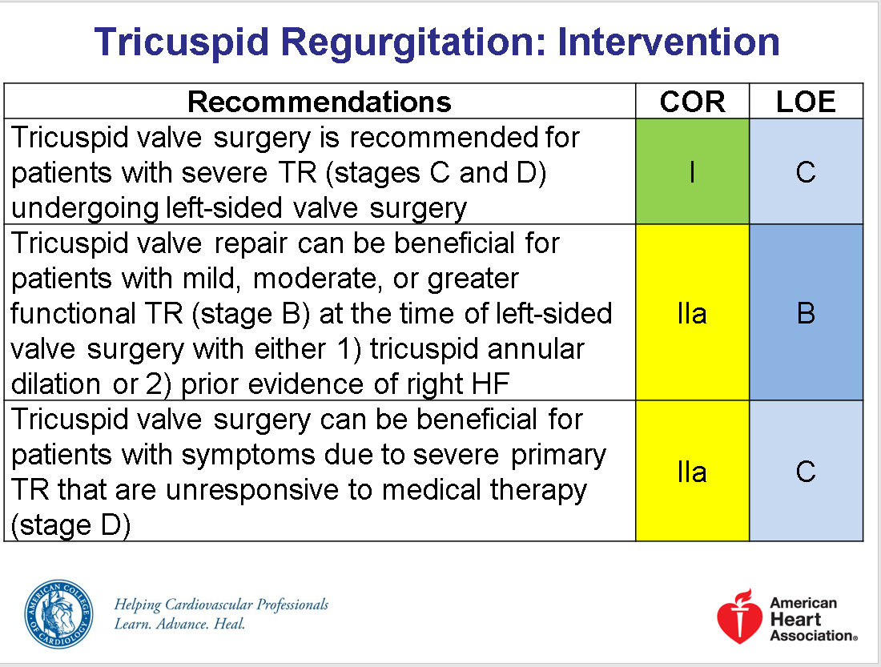
2017 ACC/ AHA guideline

Slide 54
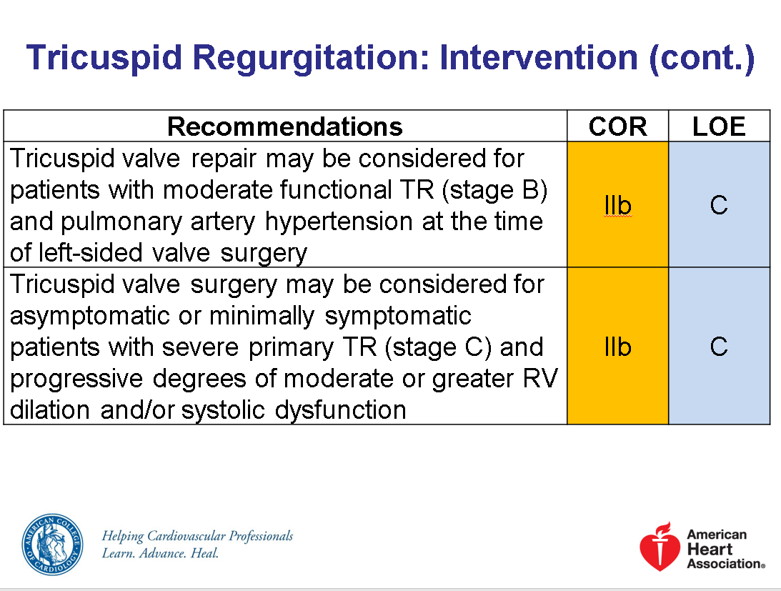

Slide 55
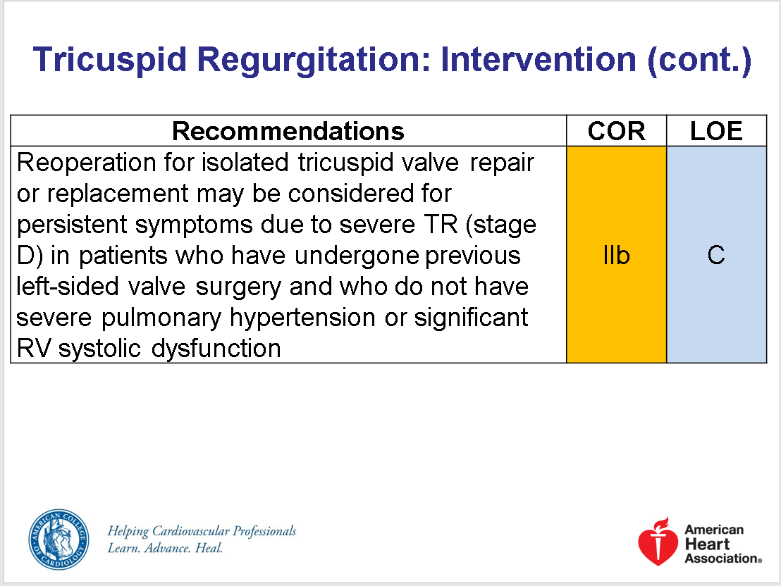

Slide 56
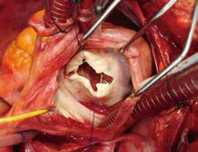
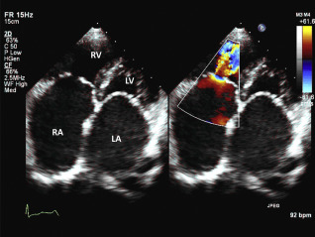
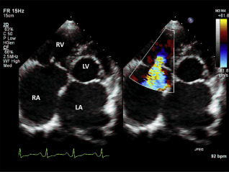
Rheumatic tricuspid valve with thickened, retracted leaflets and fused commissures.

Slide 57
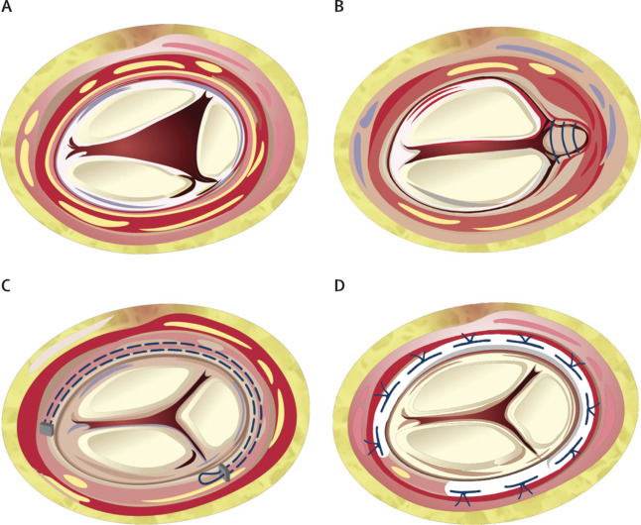
A- Dilated tricuspid annulus, lack
of leaflets coaptation
B- Repair with bicuspidization
C- Repair with De Vega sutures
(purse- string sutures)
D- Annuloplasty ring (MC-3, 3D
ring, Physio ring, Simplici-T
band, etc…..)
Tricuspid annuloplasty repair techniques

Slide 58
Dr. Arifi, KACC, 2011
Severe TR in a rheumatic patient, bicuspidization repair

Slide 59
Case 2
68-year-old man with history of chest trauma 6 months ago, presented with SOB and fatigue

Slide 60
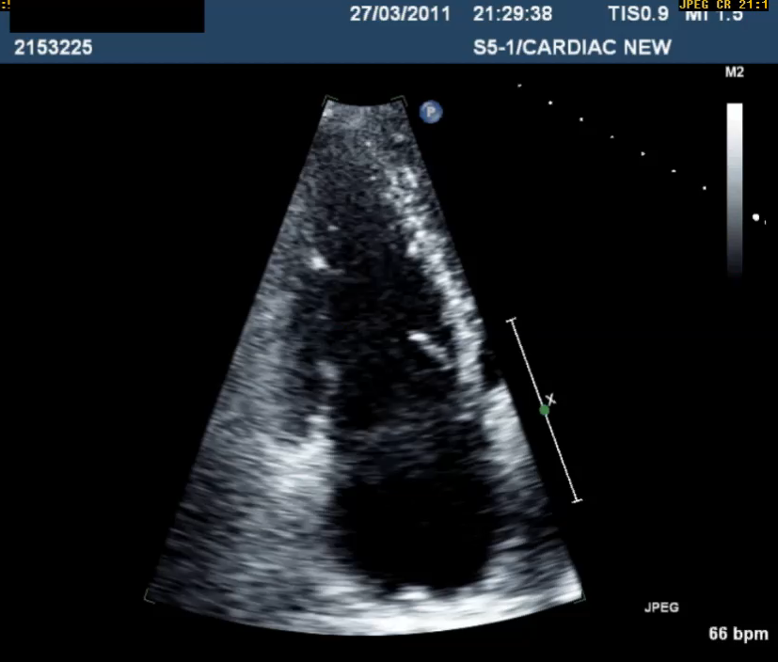
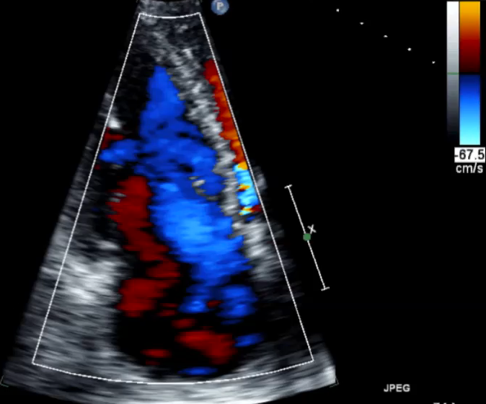

Slide 61
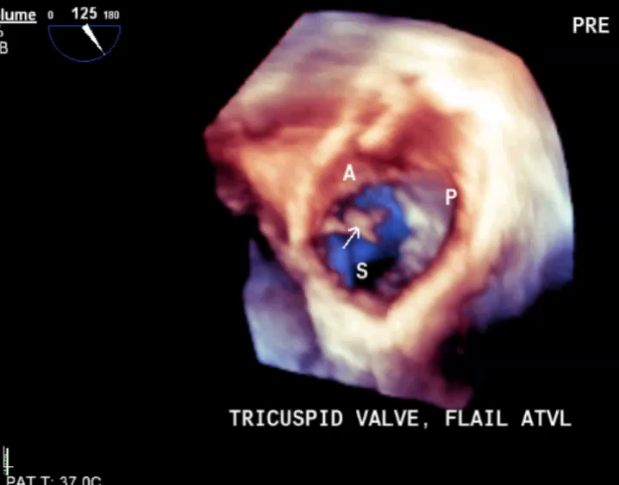

Slide 62
Dr. Arifi, KACC, 2011

Slide 63
Case 3
73-year-old female, known case of carcinoid tumor

Slide 64
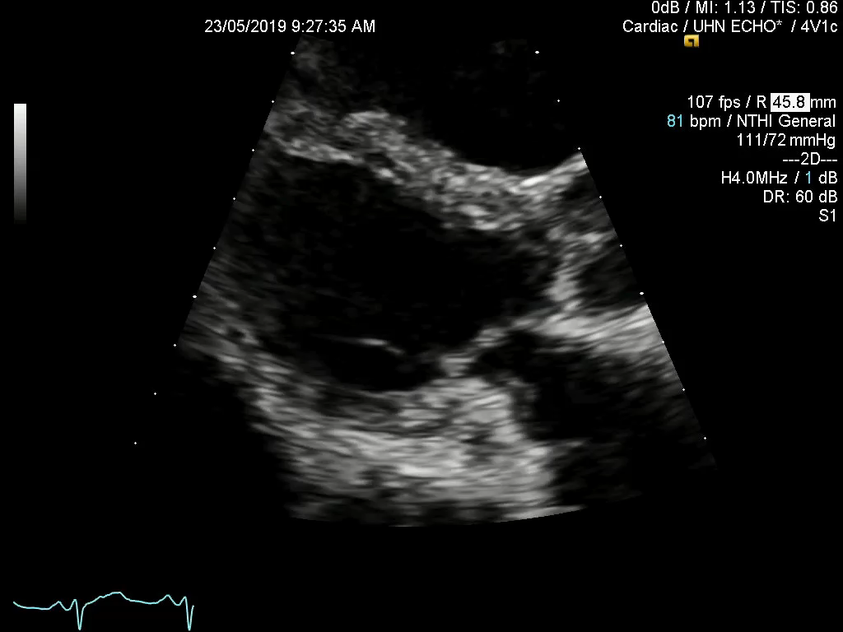

Slide 65
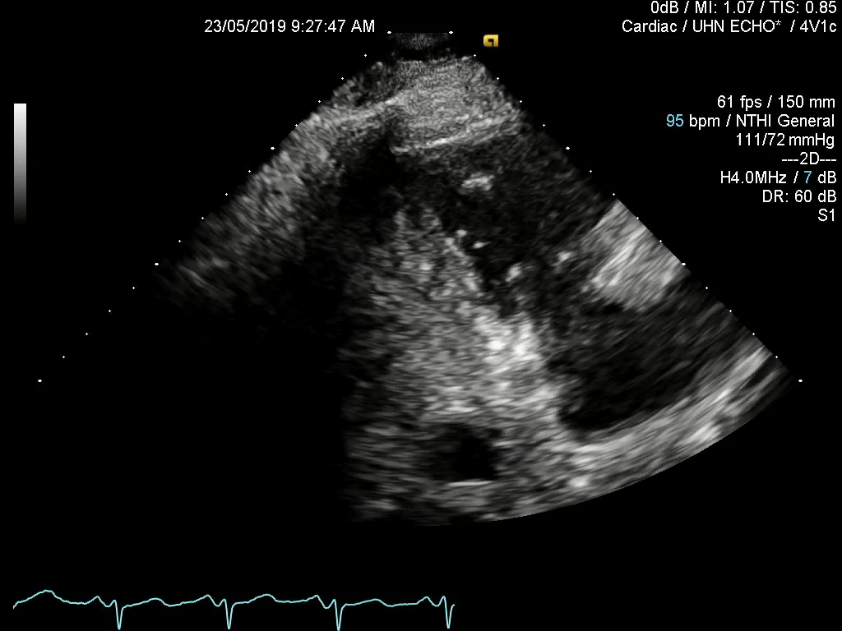

Slide 66
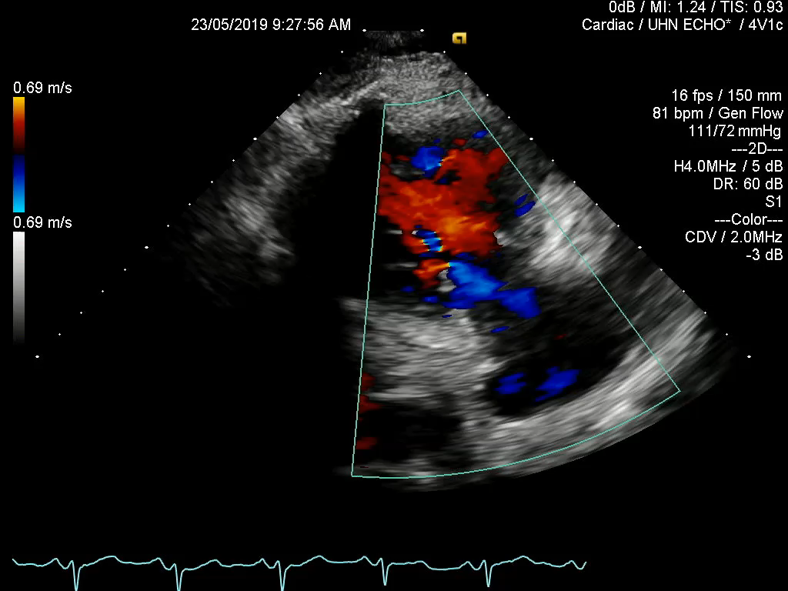

Slide 67
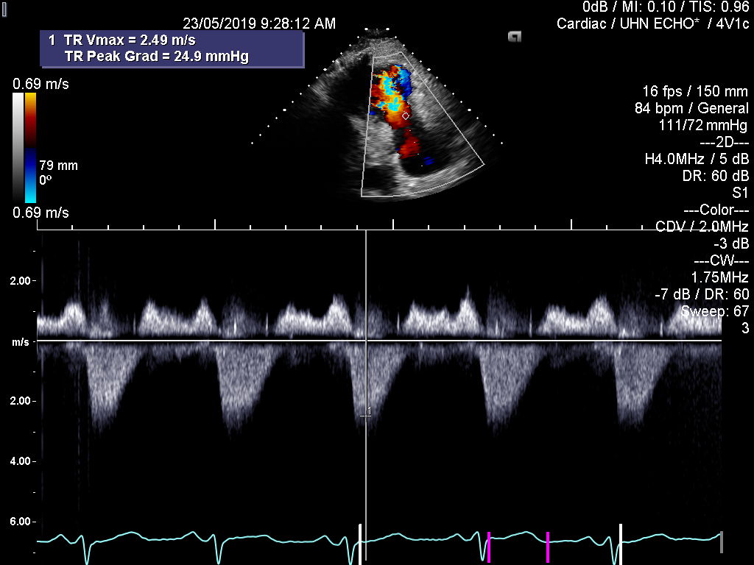
Tricuspid inflow : PIG = 10 mmHg
Mean gradient = 4 mmHg
TR: PIG = 25 mmHg
RVSP = 35 mmHg

Slide 68
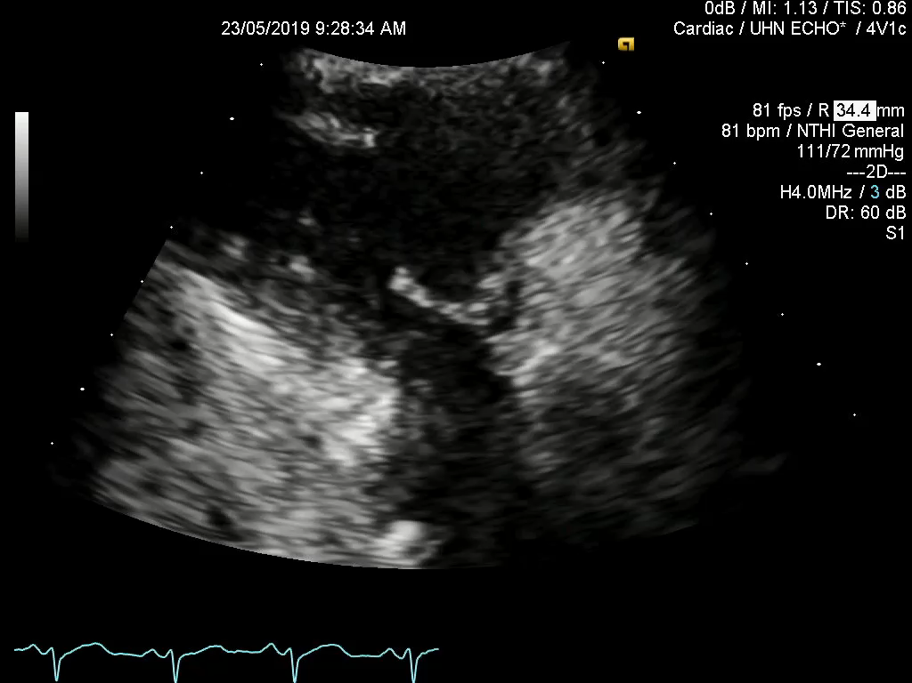

Slide 69
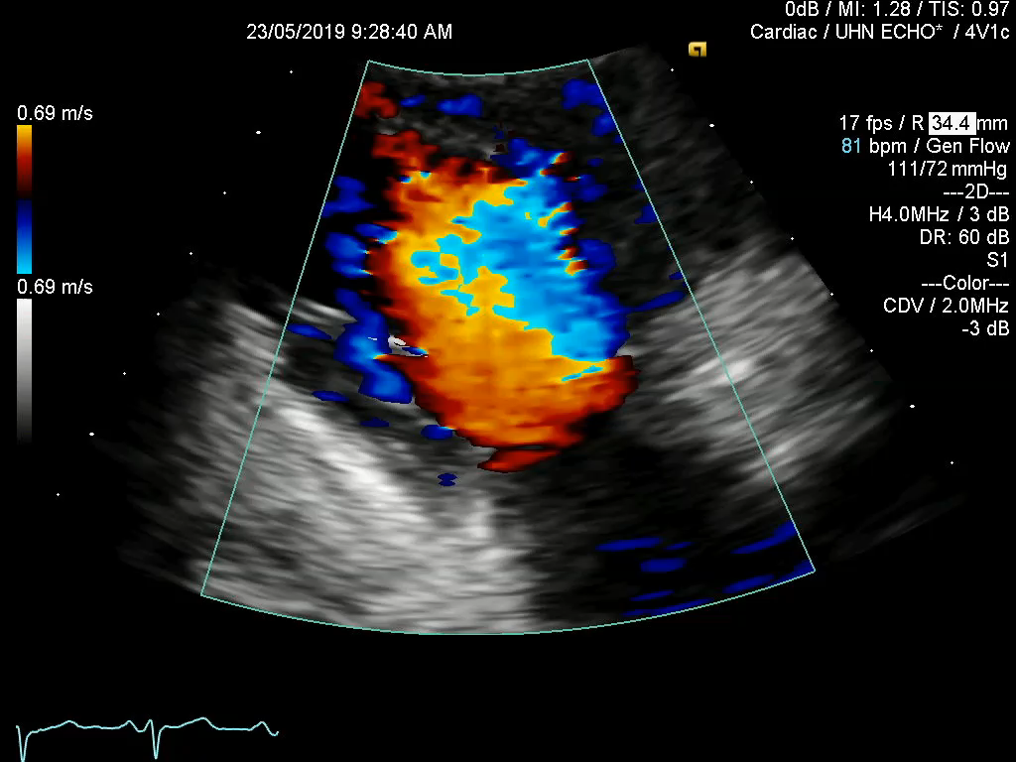

Slide 70
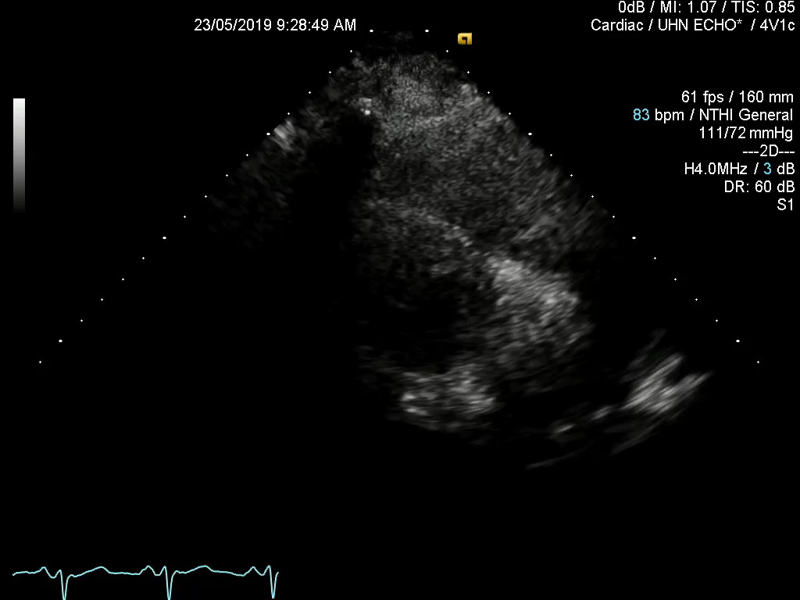

Slide 71
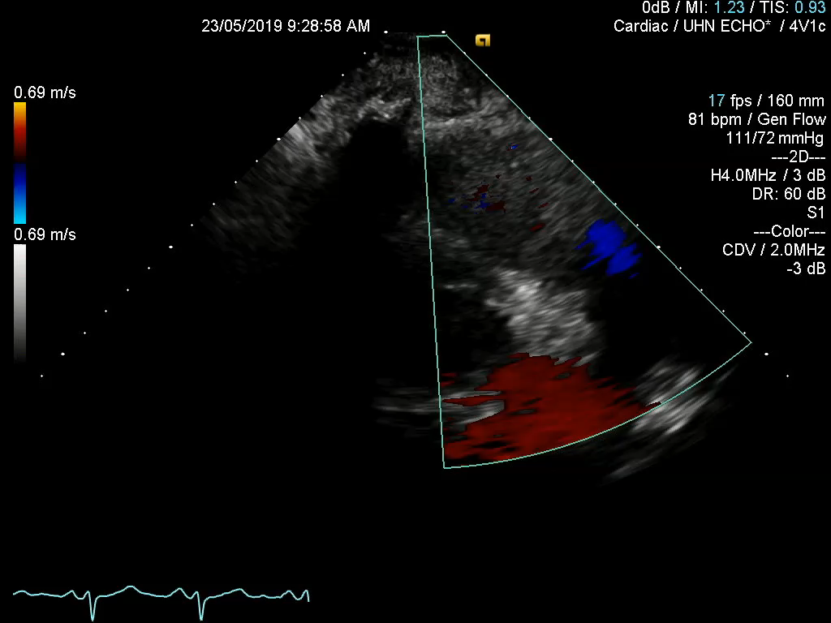

Slide 72


Slide 73


Slide 74

Thickened, restricted tricuspid leaflets

Slide 75

Restricted and regurgitant tricuspid valve with severe TR

Slide 76


Slide 77


50% of patients with carcinoid tumor develop carcinoid heart disease (TS, TR, PS, PI)

Slide 78


Firm plaque- like endocardial fibrous thickening of the inside surfaces of the cardiac chambers, tricuspid valve, and the pulmonic valve

Slide 79
Case 4
22-year-old female with history of ACHD

Slide 80


Slide 81


Slide 82


Slide 83

TV septal leaflet displacement = 2.5 cm

Slide 84

TV ? Posterior leaflet displacement = 2.6 cm

Slide 85


Slide 86


Slide 88

Functional RV

Slide 89

Anatomical RV

Slide 90

Surgeon’s view of the TV

Slide 91

AL
RAA
AL
PL
SL

Slide 92
AL
RAA
AL
PL
SL

Slide 93
Patient underwent TV repair

Slide 94


Slide 95


Slide 96


Slide 97


Slide 98


Slide 99


Slide 100
F/U echo in 6 weeks

Slide 101


Slide 102


Slide 103


Slide 104


Slide 105


Slide 106


Slide 107


Slide 108
J Thorac Cardiovasc Surg 2007

Slide 110
A
B
C

Slide 111
Completed cone reconstruction of the tricuspid valve+ longitudinal plication of the tricuspid annulus and atrialized right ventricle. No annuloplasty ring was used.

Slide 112
Pulmonic (pulmonary) valve disease

Slide 113
2009 ASE guideline

Slide 114
2017 ASE guideline

Slide 115
2017 ASE guideline

Slide 116
2017 ASE guideline

Slide 117
2017 ASE guideline

Slide 118
Suggested reading materials
Echocardiographic Assessment of Valve Stenosis: EAE/ ASE Recommendations for Clinical Practice. JASE 2009.
2017 AHA/ ACC Focused Update of the 2014 AHA/ ACC Guideline for the Management of Patients with Valvular Heart Disease.
Recommendations for Noninvasive Evaluation of Native Valvular Regurgitation. A Report from the American Society of Echocardiography Developed in Collaboration with the Society for Cardiovascular Magnetic Resonance.

Slide 119
Questions

Slide 120
Question 1
Which of the following statements about tricuspid valve anatomy is CORRECT?
Anterior tricuspid leaflet is adjacent to the coronary sinus
Anterior tricuspid leaflet is adjacent to the IVC
Tricuspid septal leaflet is adjacent to the IVC
A-V node is adjacent to the commissure between anterior and posterior leaflets

Slide 121
Question 2
All of the following statements about severe of TR are correct EXCEPT
There is a flow reversal in hepatic vein Doppler
CW Doppler is parabolic shape
Tricuspid inflow Doppler E velocity is more than 1.0 m/s
Regurgitant volume by PISA method is more than 45 ml/beat

Slide 122
Question 3
Which of the following statements about etiology of TR is CORRECT?
Right side endocarditis is the most common cause of TR in North America
Carcinoid heart is the most common cause of the TR
Atrial fibrillation is common in idiopathic TR
In Ebstein’s anomaly of the tricuspid valve, most of the time anterior leaflet is displaced

Slide 123
Question 4
All of the following statements about tricuspid stenosis (TS) are correct EXCEPT
Carcinoid heart is the most common cause of the isolated TS
Rheumatic TS is associated with rheumatic mitral valve in most of the cases
Pacemaker lead can cause severe TS
RV dilatation is an echo sign of isolated TS

Slide 124
Question 5
All of the following statements about pulmonary regurgitation are correct EXCEPT
PR index in CW Doppler is less than 0.77
There is diastolic flow reversal in pulmonary branches
Regurgitant fraction is more than 40%
Pressure half-time of PR jet is less than 250 ms

Slide 125
Correct Answers
1- C
2- B
3- C
4- A
5- D

Slide 126

Thank you.

