Slide 1
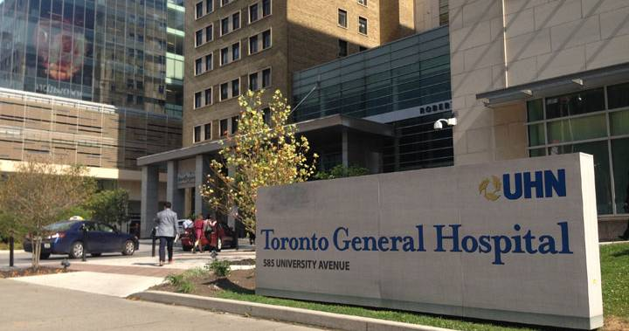


Ahmad S. Omran MD, FACC, FESC, FASE
Cardiology Consultant
Department of Anesthesia and Pain Management
Toronto General Hospital- UHN
University of Toronto

Slide 2
Ventricular Function
(Systolic, LV and RV)
Aug 14, 2019
Department of Anesthesia and Pain Management- TGH, Toronto

Slide 3
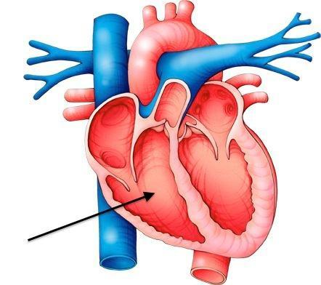
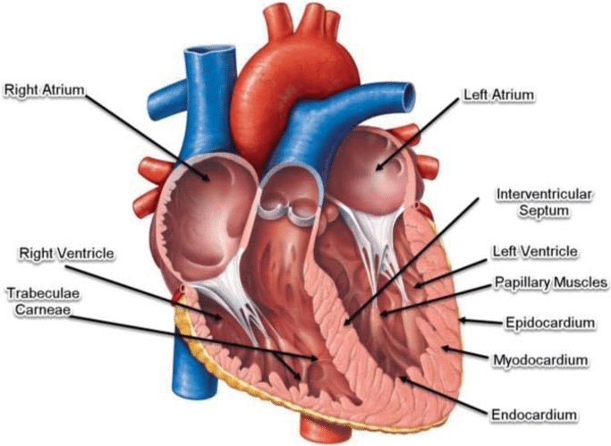
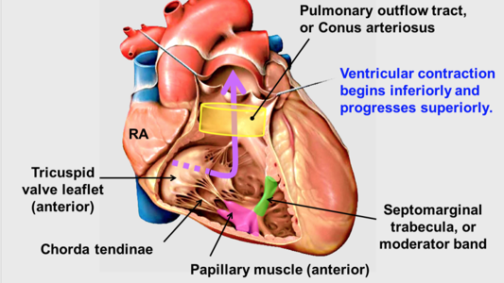

Slide 4
Functional anatomy of the RV
Right ventricle is a right- anterior structure. It consists of an inlet, coarse trabecular and outlet segments.
Morphologic TV is always connects to morphologic RV by chordae and 3 papillary muscles. Prominent arch-shaped muscular ridge known as crista supraventricularis is separating TV from PV.
Prominent moderator band forms an intracavitary muscle that connect the septal band with the anterior tricuspid papillary muscle.
The outflow portion of the RV, conus or infandibulum is a smooth-walled muscular subpulmonary channel.

Slide 5
Functional anatomy of the LV
LV is made of inlet, outlet and a finely trabeculated apical zone.
Average thickness of LV free wall is about 7-11 mm and is 3 times thicker than RV free wall.
Morphologic MV always connects to morphologic LV.
LV chamber in cross section appears circular (donut) whereas RV chamber appears crescentic (banana).
Two papillary muscles (anterolateral and posteromedial) are connecting MV to the LV wall.
LV false tendons are discrete, thin that connect two walls of LV.
In cardiac imaging LV wall are divided in to 16, 17 or 18 segments.

Slide 6
Functional anatomy of the RA
Crista terminalis is a prominent internal muscle ridge which separates the RA free wall into:
a) smooth-walled posterior region that receives the IVC, SVC
and coronary sinus.
b) muscular anterior region that is lined by parallel pectina
muscles and form the right atrial appendage (RAA).
Inferior vena cava (IVC) blood flow is directed by the Eustachian valve towards the foramen ovale. Superior vena cava (SVC) blood is directed towards the TV.
Coronary sinus blood is directed into the RA via a rudimentary valve called Thebesian valve.

Slide 7
Functional anatomy of the LA
Left pulmonary veins (LUPV and LLPV) are connected to the posterolateral and right pulmonary veins (RUPV and RLPV) are connected to the posteromedial aspect of LA.
Left atrial appendage (LAA) arises anterolaterally in the left A-V groove. LAA is smaller, more tortuous and has narrower base compared to RAA. At least 80% of times, LAA are multilobed.
In contrast to the right atrial free wall, the LA has no crista terminalis and no pectina muscle outside its appendage.
Coronary sinus (CS) travels along the posterior wall of the LA within the left A-V groove.
Esophagus and descending aorta are in contact with posterior LA wall.

Slide 8
Functional anatomy of the ventricular septum
Ventricular septum is a complex intracardiac partition that can be considered to comprise of four parts: inlet, trabecular, membranous and infundibular.
Defect in each portion of septum creates ventricular septal defect (VSD). Majority of clinically significant VSDs are membranous type.
Age-related basal septal hypertrophy or sigmoid shape septum can be seen by echocardiography in older people and should be differentiated with other causes of left ventricular hypertrophy .

Slide 9
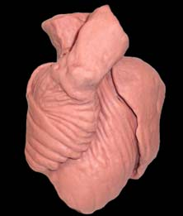
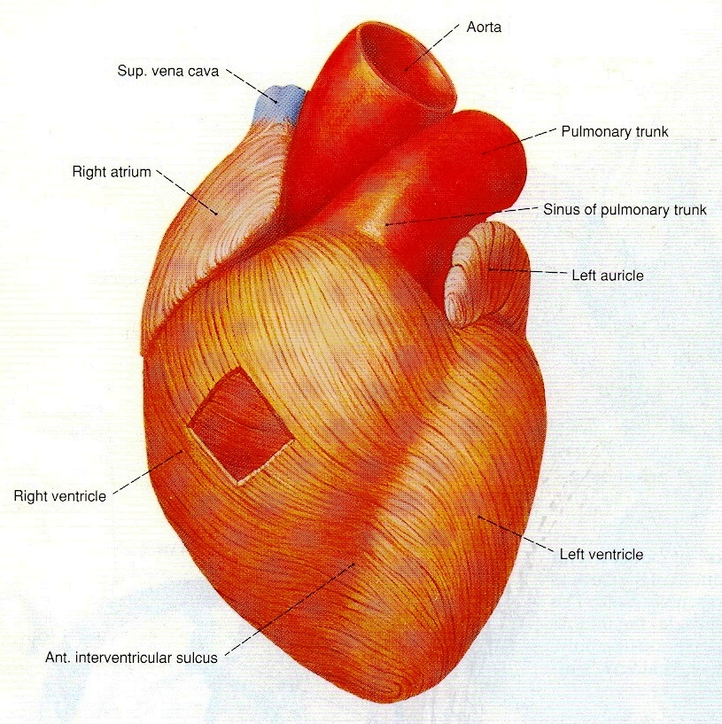
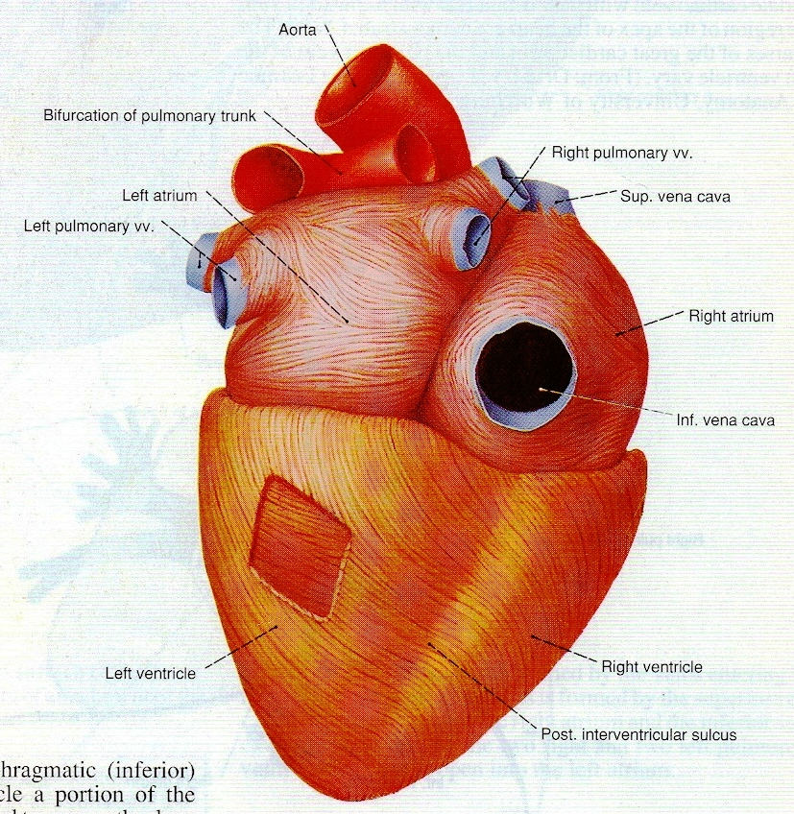
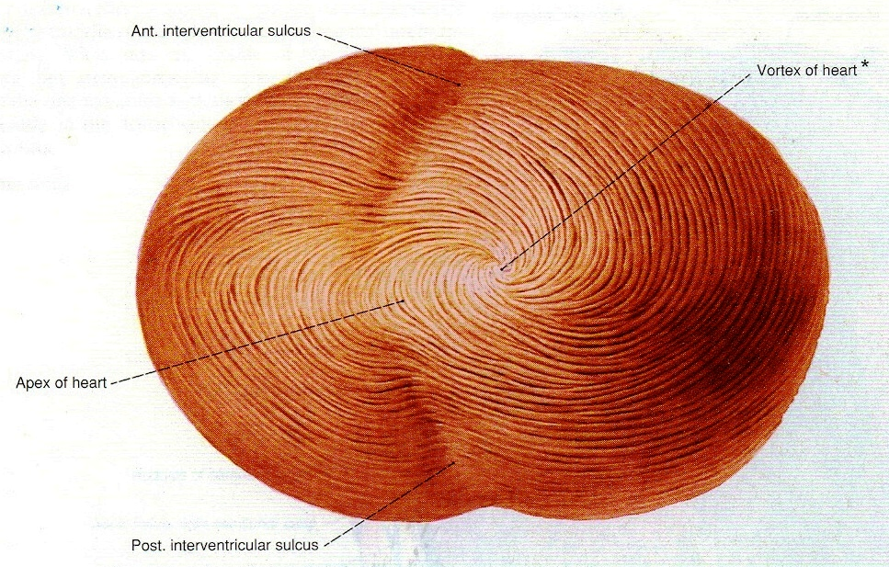
RV wall
LV wall
Helical structure of the heart was thought about 500 years ago, but Dr. Torrent-Guasp (Spanish, died in 2005) was the first to unfold this anatomic architecture. The helical shape of the heart causes twisting and untwisting to eject the blood in systole and suctioning of the blood in diastole. Disruption of this function happens when the geometry of the heart changed from normal conical shape to diseased spherical shape as happens in patients with CHF.
RV
LV
Apex of the heart

Slide 10
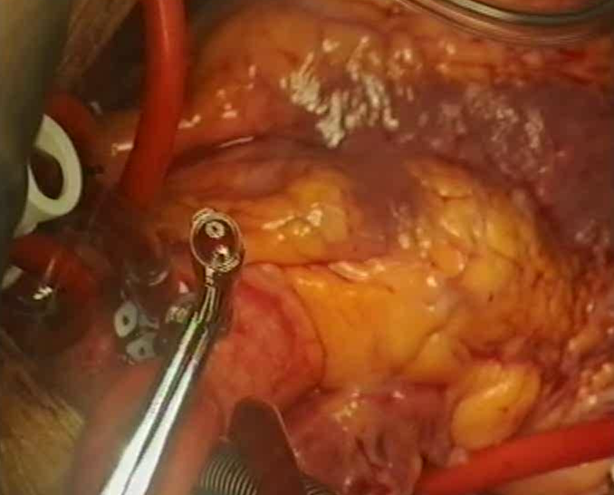

Slide 11
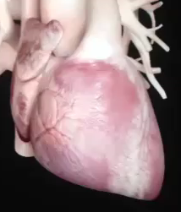


Clockwise rotation
- 7⁰
(-)
Twist (torsion) & Untwist
First, was described by Lower in 1669 as “……the wringing of a linen cloth to squeeze out the water”
(+)
+ 13⁰
Counter-clockwise rotation

Slide 12
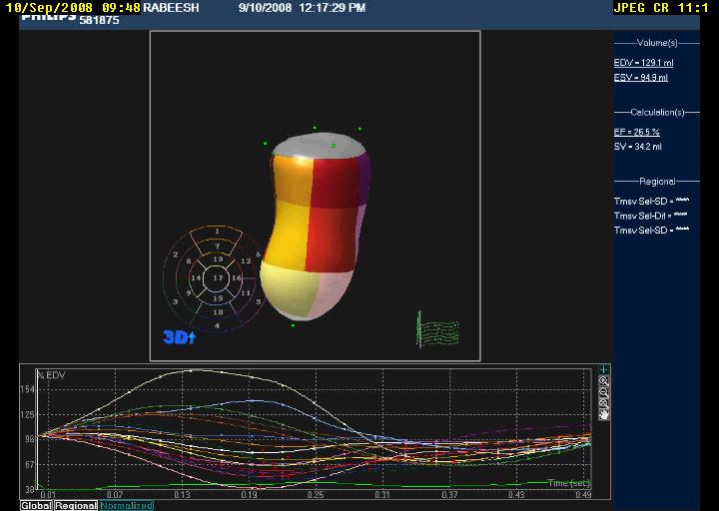
LV with large apical aneurysm

Slide 13
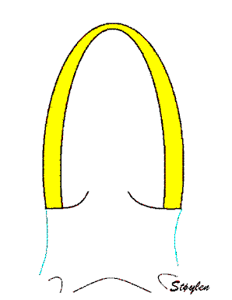
Longitudinal contraction of LV

Slide 14
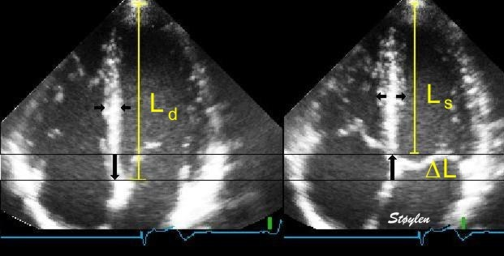
Longitudinal contraction of the LV

Slide 15
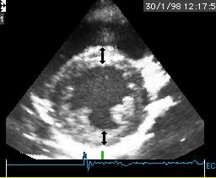
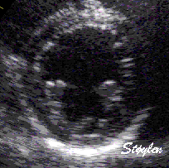
Radial contraction of the LV
Circumferential contraction of the LV

Slide 16
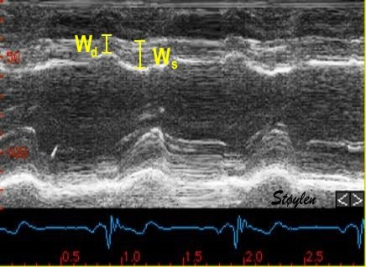
M-mode of the left ventricle showing radial contraction of the LV

Slide 17
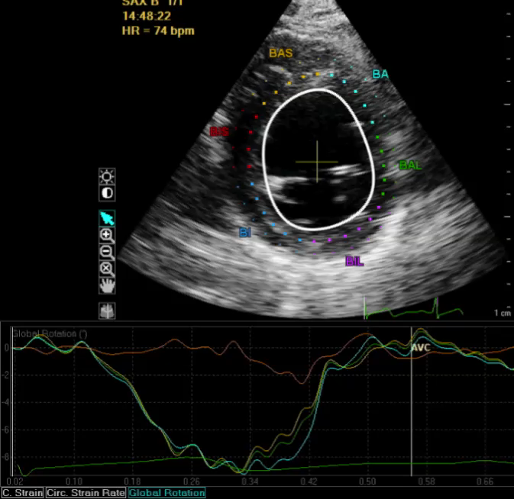
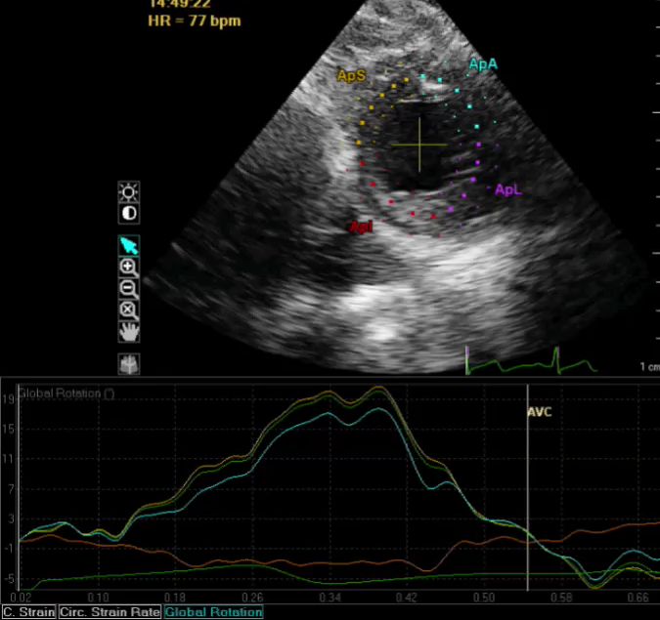
Basal LV, clockwise rotation= -8 degrees (N= -7)
Apical LV, counter-clockwise rotation= + 19 degrees (N= +13)
51-year-old male with severe AS, AI

Slide 18
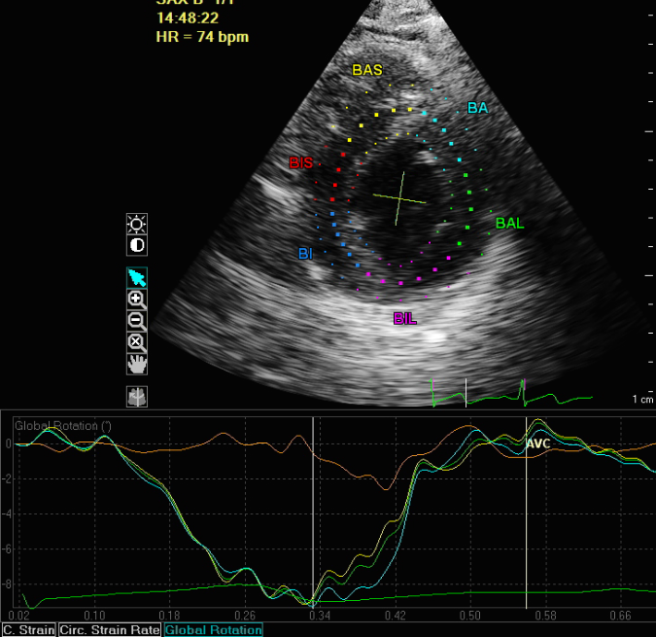
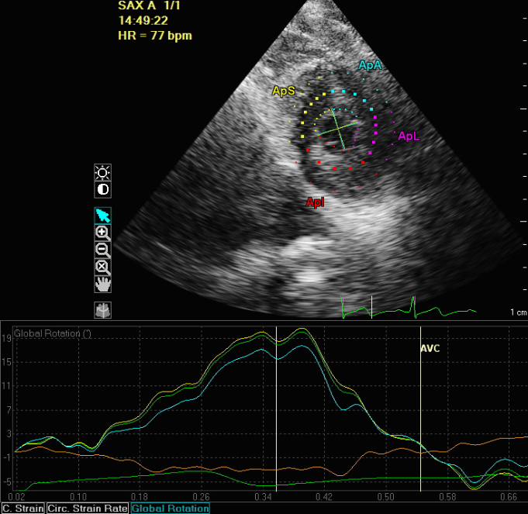
- 8 degrees
+ 19 degrees
+19 degrees
-8 degrees
(0)
(0)
Net LV twist angle = 27 degrees (Normal= 20)

Slide 19
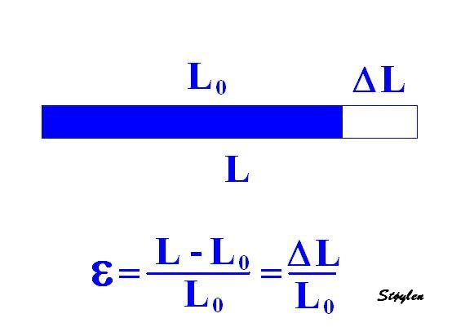
Strain, “stretching” means the deformation( unit less)

Slide 20
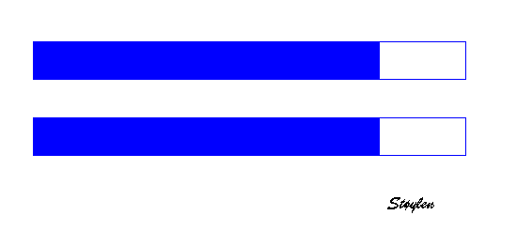

Strain Rate is the rate by which the deformation occurs, i.e. deformation of strain per time unit. The unit of strain rate is /s or s⁻¹.

Slide 21
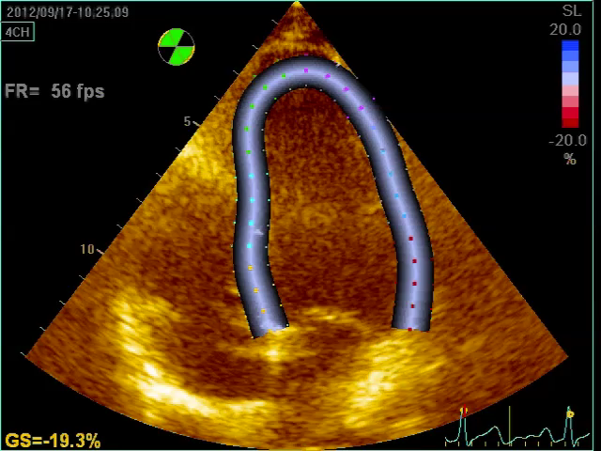
Positive strain
“lengthening”
Negative strain
“Shortening”

Slide 22
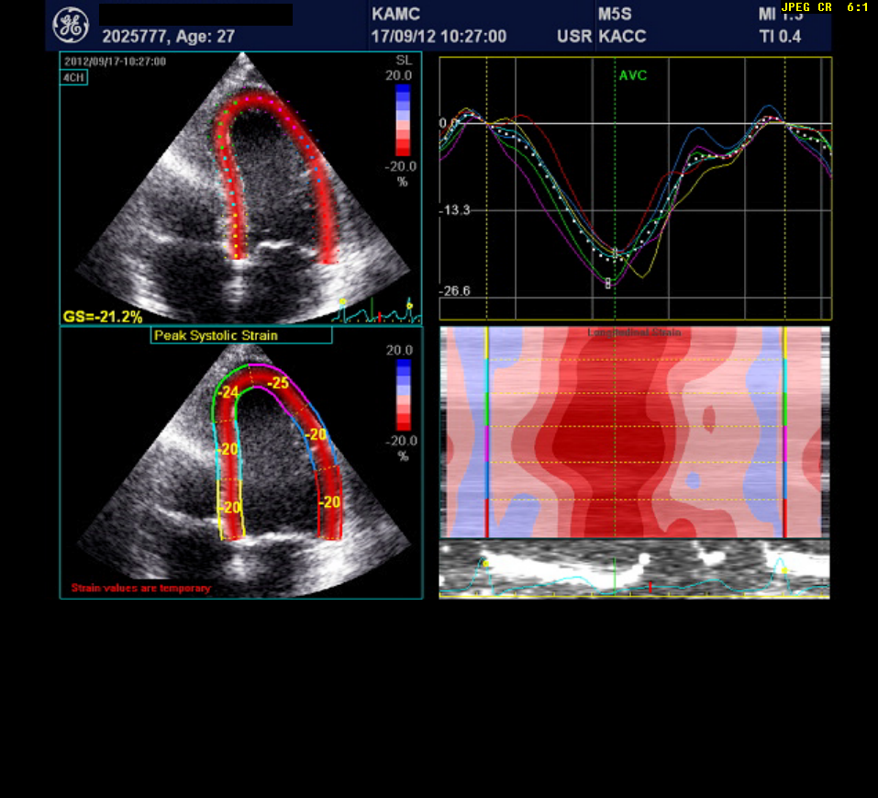
GLS
Shortening
Lengthening

Slide 23
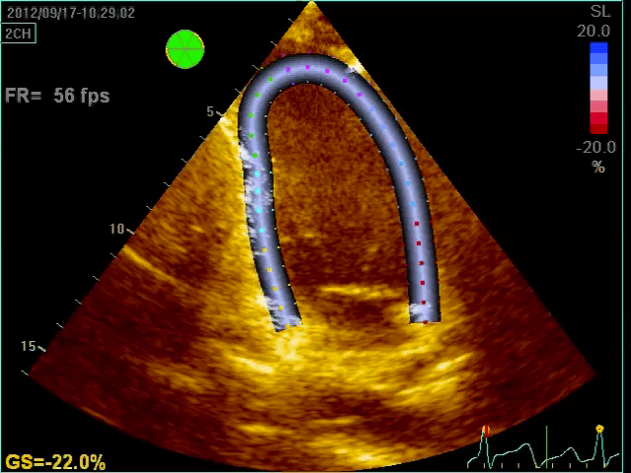
LV apical 2-chamber view

Slide 24
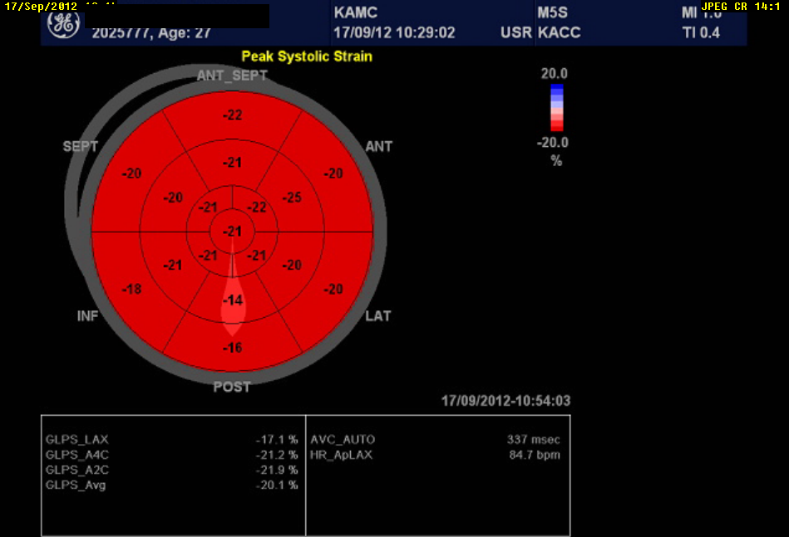
-20.1%
“Bull’s eye” plot of strain values for each of the 17 myocardial segments

Slide 25
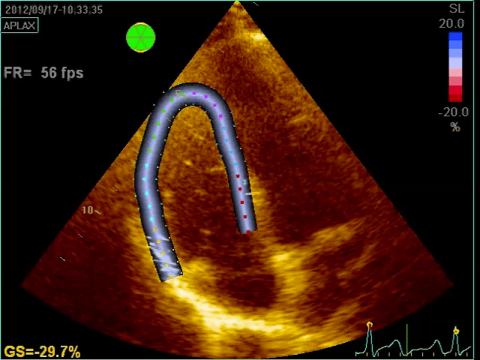
RV longitudinal global strain= -29.7%

Slide 26
Contractile Performance of the Intact Heart
There are 4 main determinants of myocardial contractile
performance:
Contractility ( inotropic state of the myocardium)
Loading conditions
Heart rate
Synergy of LV contraction ( ventricular synchrony)

Slide 27
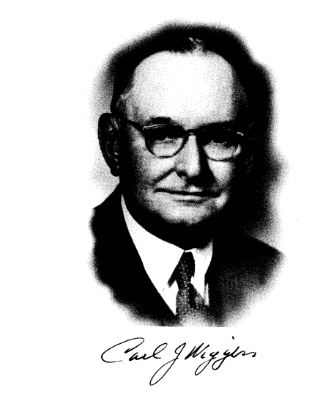
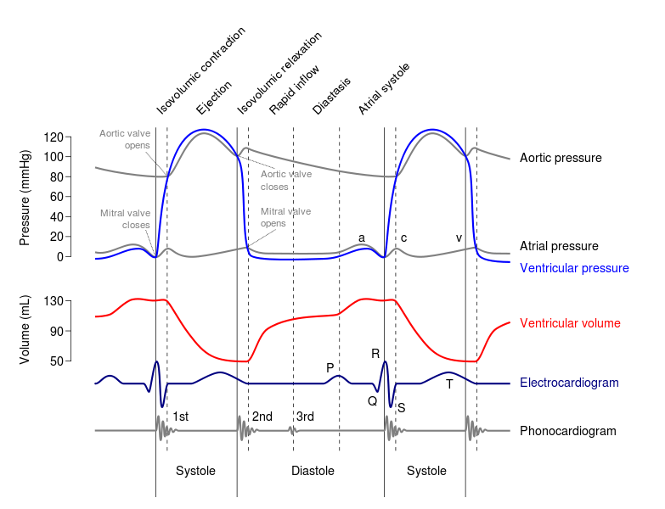
1883- 1963
Wiggers diagram for cardiac events (left heart)
The mechanical events in the cardiac cycle, first assembled by Lewis in 1920 but conceived earlier by Wiggers, in 1915.

Slide 28
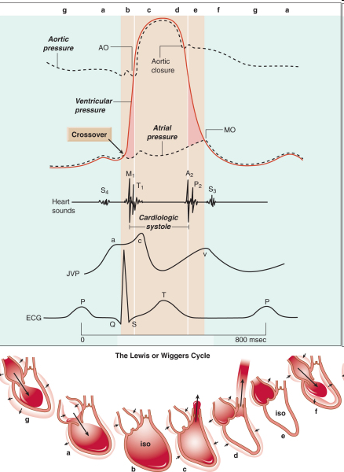

Slide 29
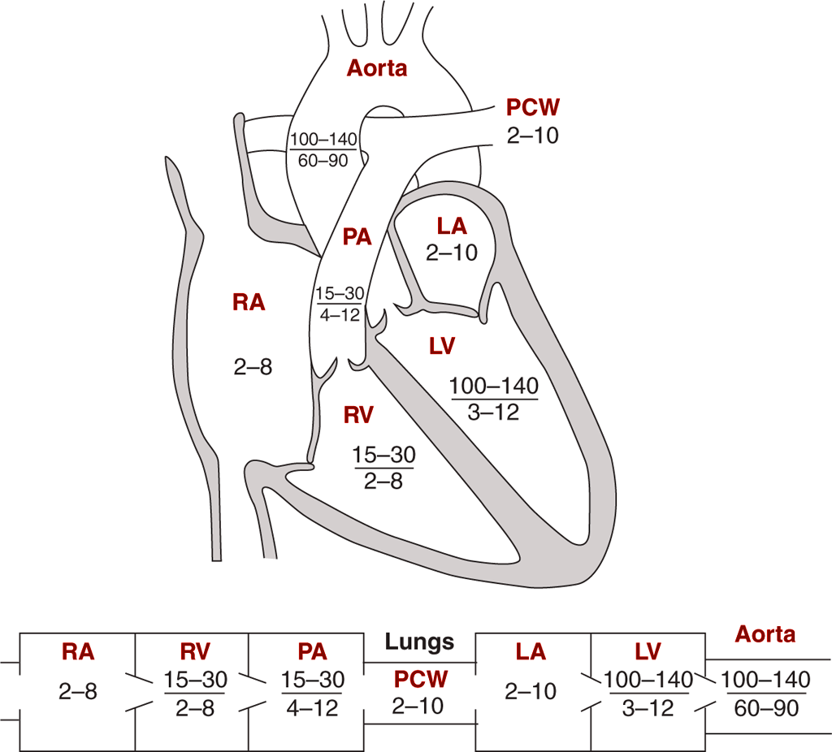
Normal pressures in cardiac chambers

Slide 30
How to assess RV and LV systolic function by TEE?

Slide 31
JASE 2015

Slide 33
Cont.

Slide 34
Cont.

Slide 35
Cont.

Slide 37
Normal values for cardiac chambers by 2D TTE, strain, and 3D were assessed in WASE trial and is going to be presented in ESC 2019 in Paris.

Slide 38
16 segments model, 1995
17 segments, 2005
18 segments, 2015
ASE 2015 chamber quantification guideline

Slide 39
17 segments model (TTE views)

Slide 40
18 segments model (TEE views)
3
6
4
1
5
2
9
12
7
8
10
11
15
16
14
18
13
17

Slide 41
2013 ASE guideline on comprehensive TEE

Slide 42
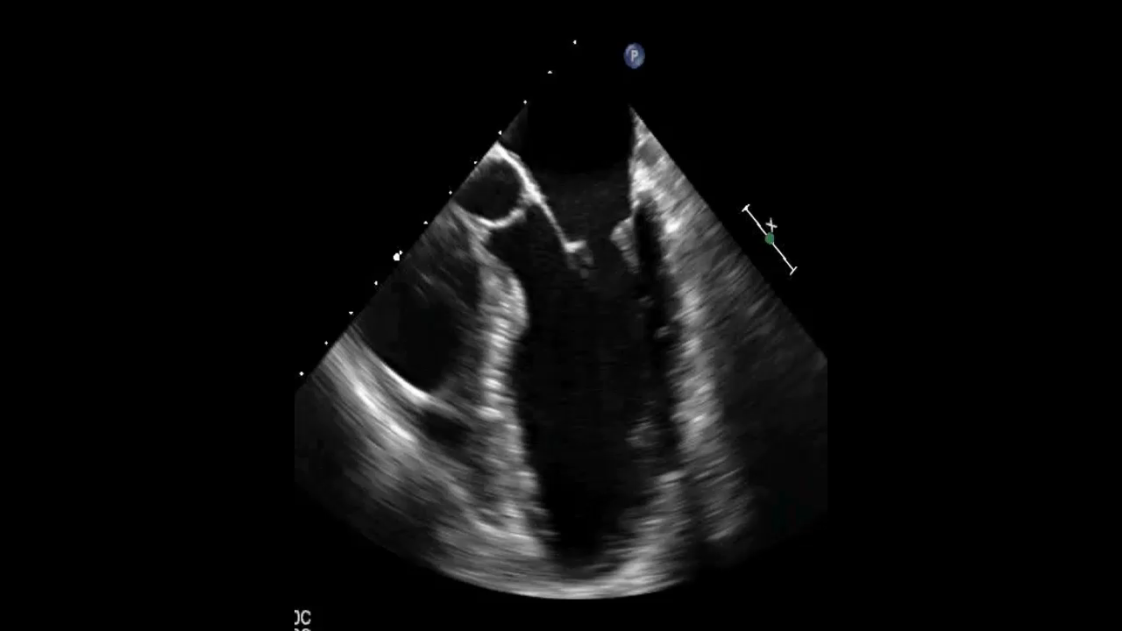
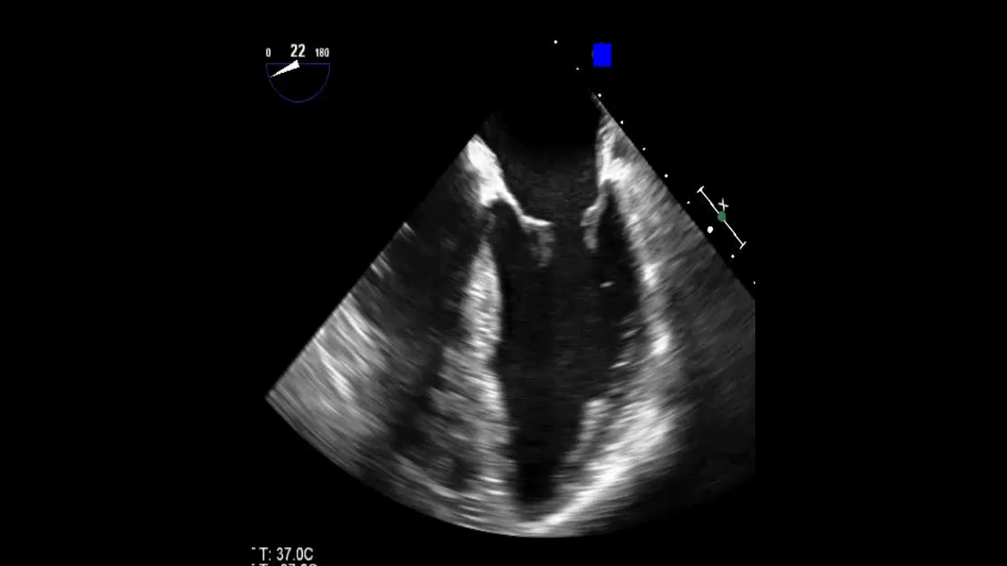
LA
LA
RA
RA
AoV
RV
RV
LV
LV
1- ME 5-Chamber View
2- ME 4-Chamber View

Slide 43
Correction: LAA?

Slide 44
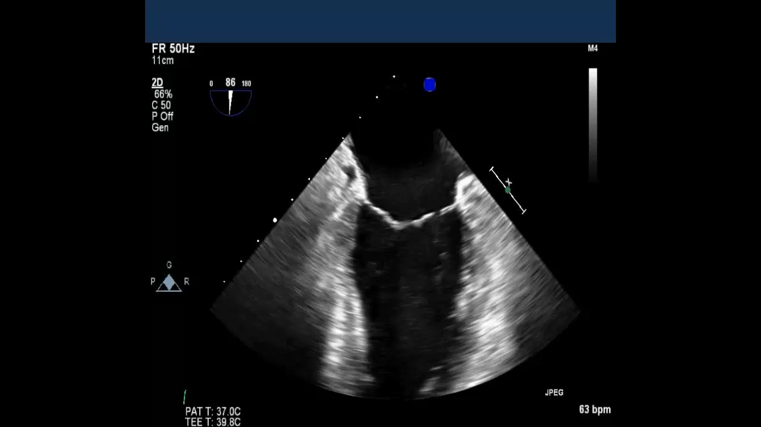
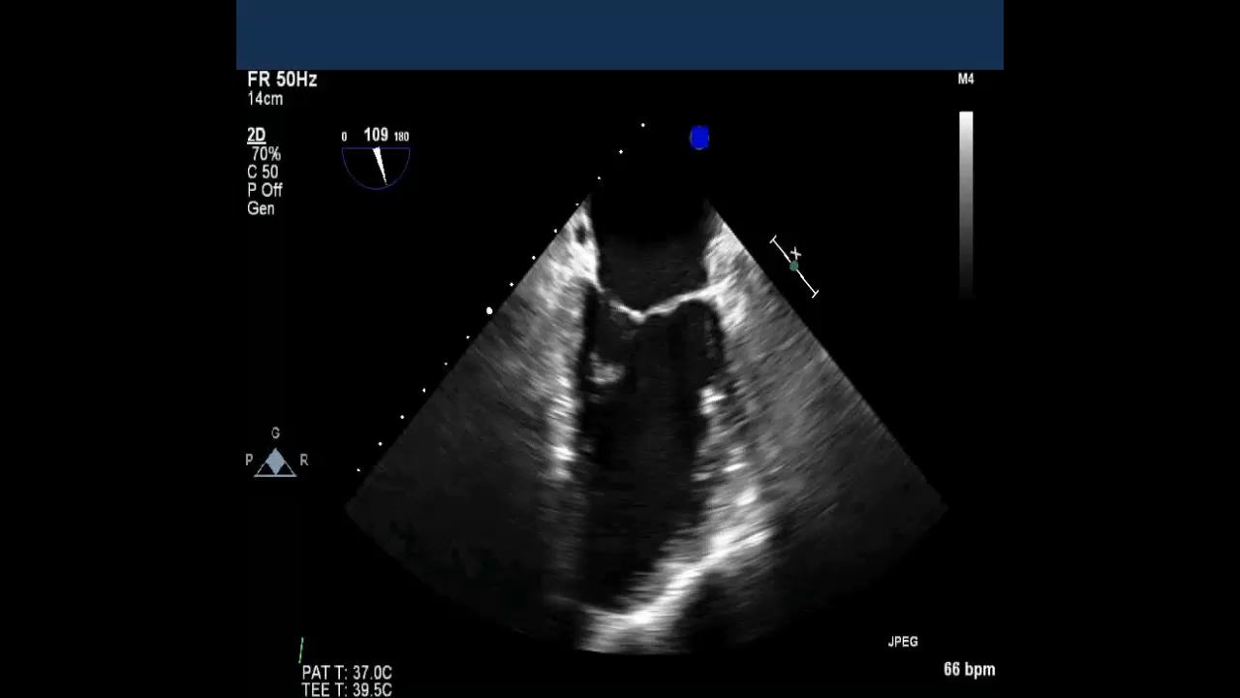
LA
LA
PMC
ALC
LV
LV
3- ME Mitral Commissural View
4- ME 2-Chamber View

Slide 46
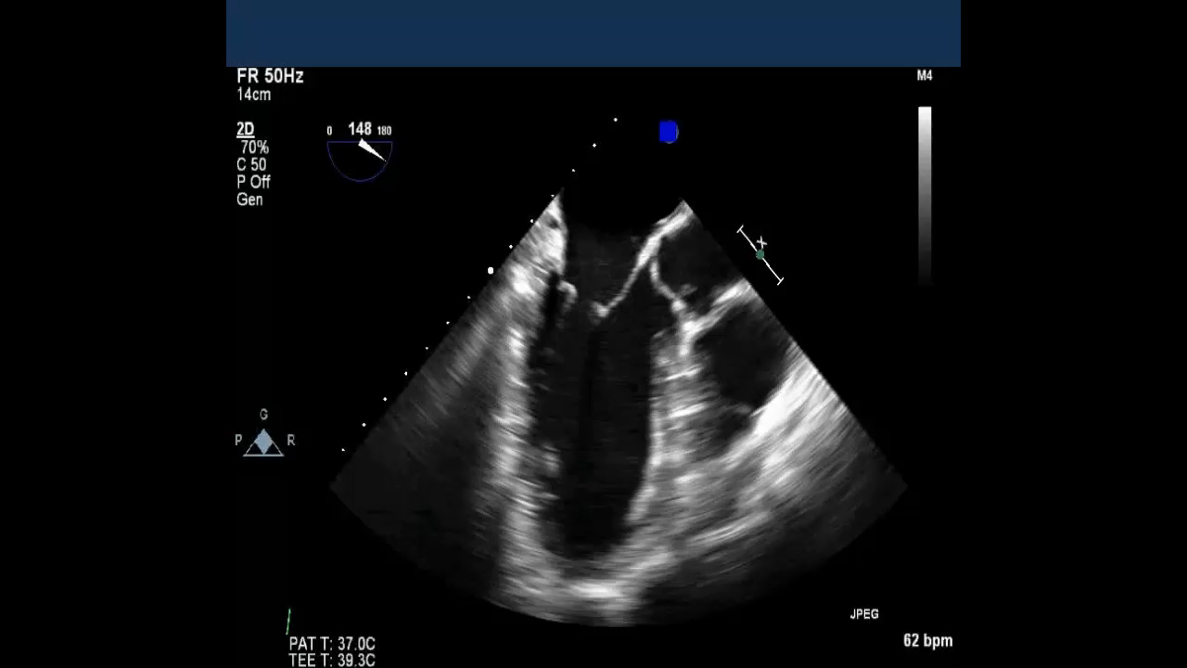
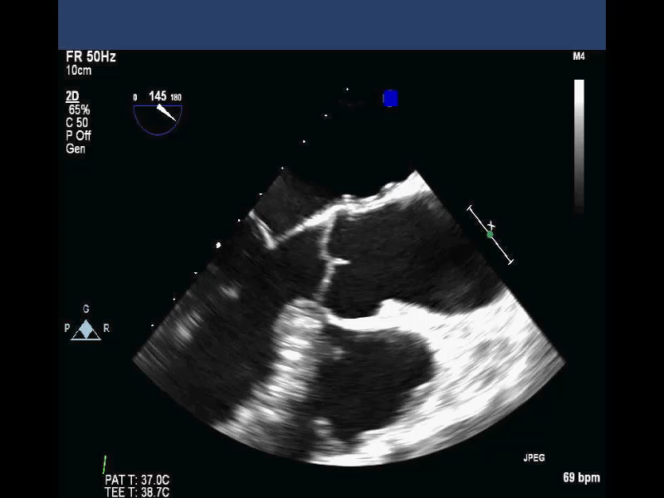
LA
LVOT
AoV
Aortic root
LV
RV
5- ME Long Axis View
6- ME AV LAX View

Slide 48
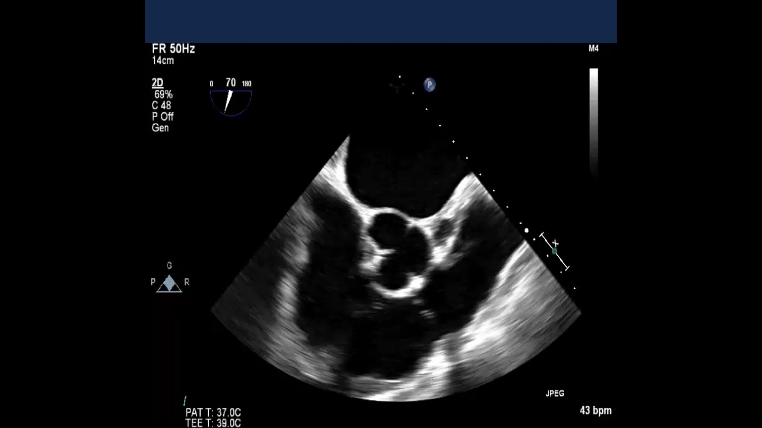
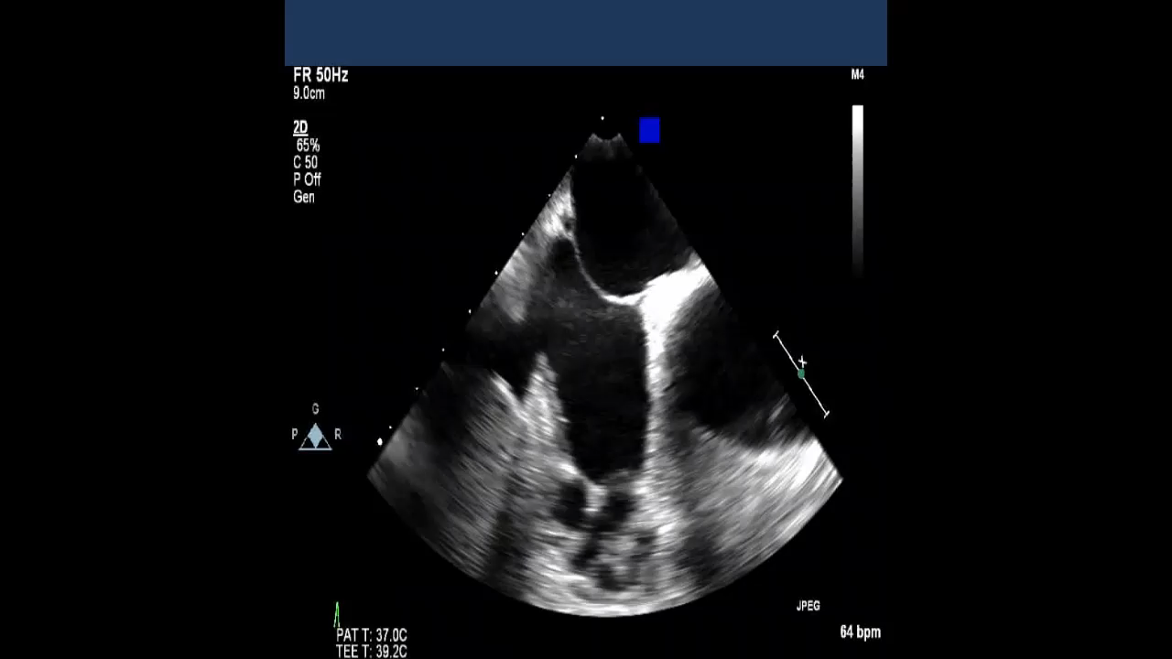
RA
RA
RA
TV
TV
RVOT
11- ME RV Inflow-Outflow View
12- ME Modified Bicaval TV View

Slide 50
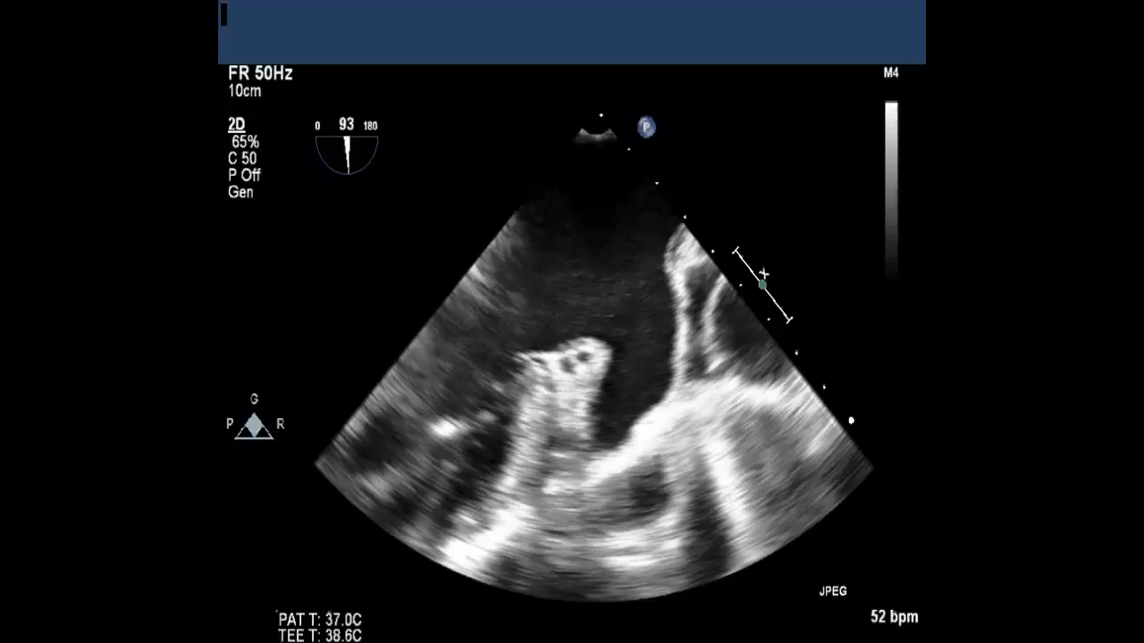
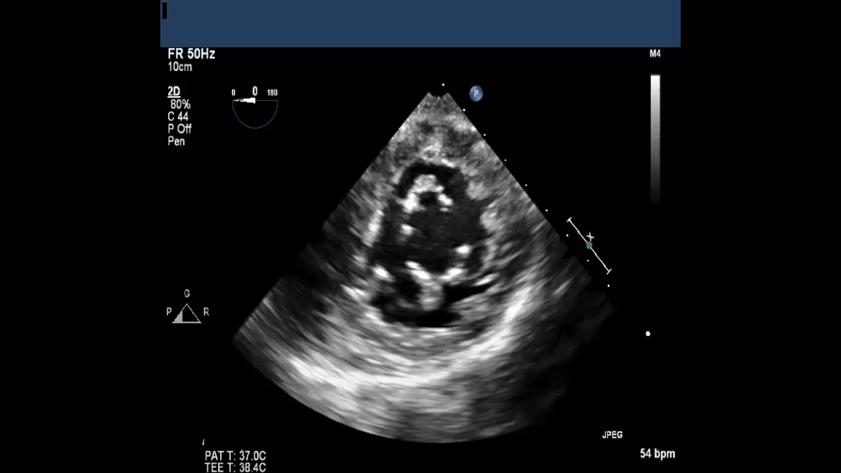
LUPV
MPA
MV SAX
LAA
Transverse sinus
15- ME Left Atrial Appendage View
16- TG Basal SAX View

Slide 52
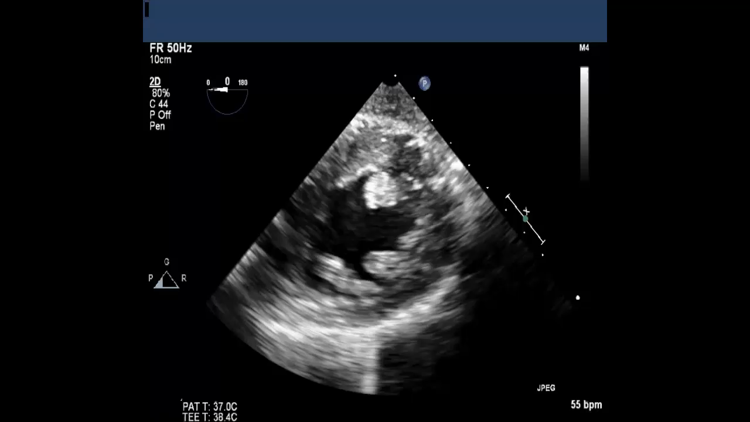
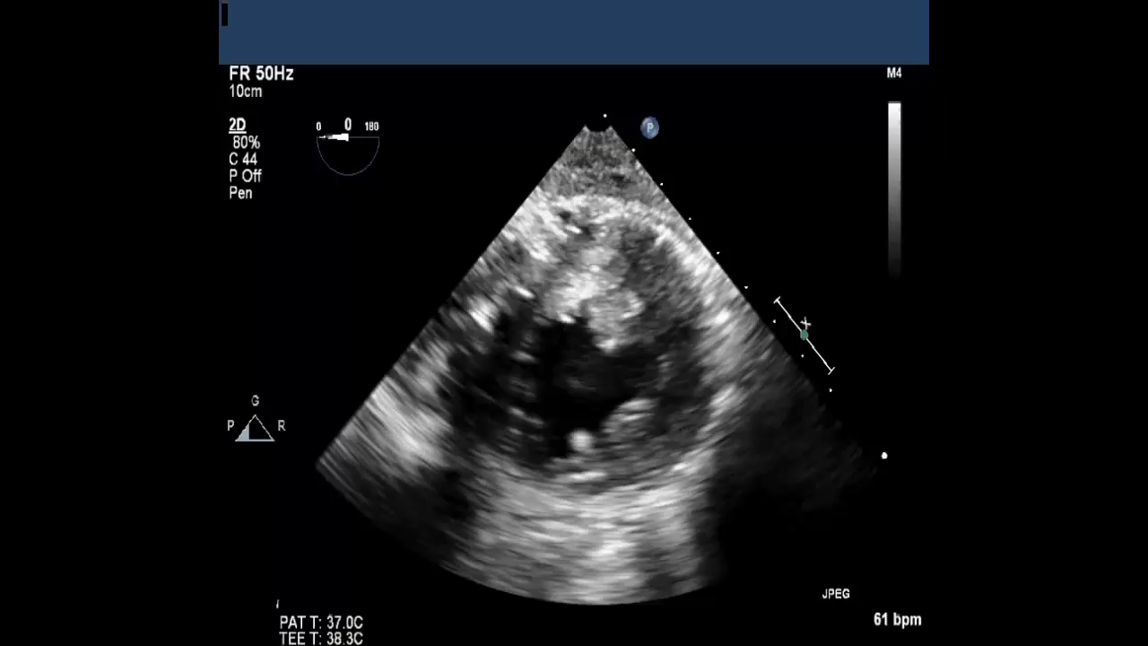
17- TG Mid Papillary SAX View
18- TG Apical SAX View

Slide 54
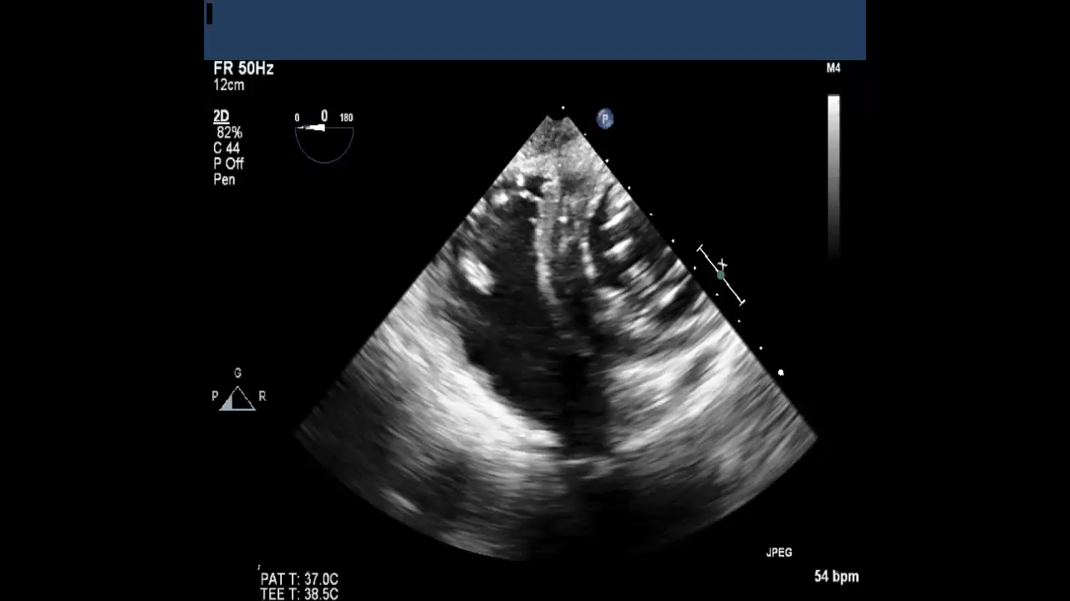
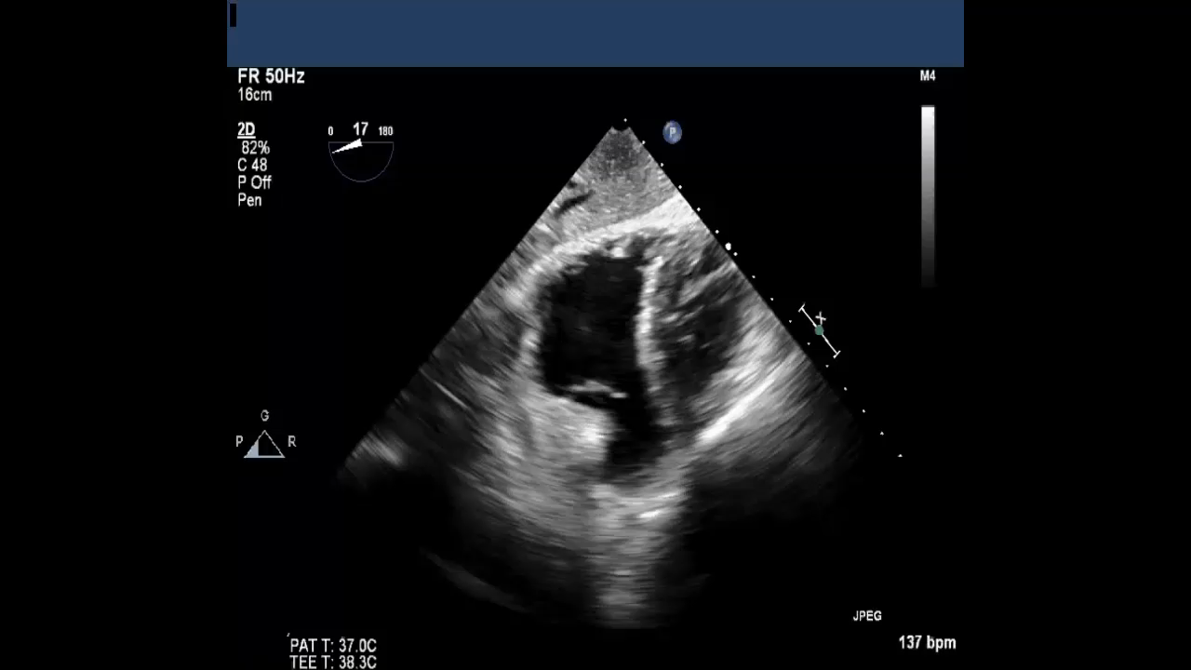
RV
TV
RA
RVOT
RVOT
19- TG RV Basal View
20- TG RV Inflow-Outflow View

Slide 56
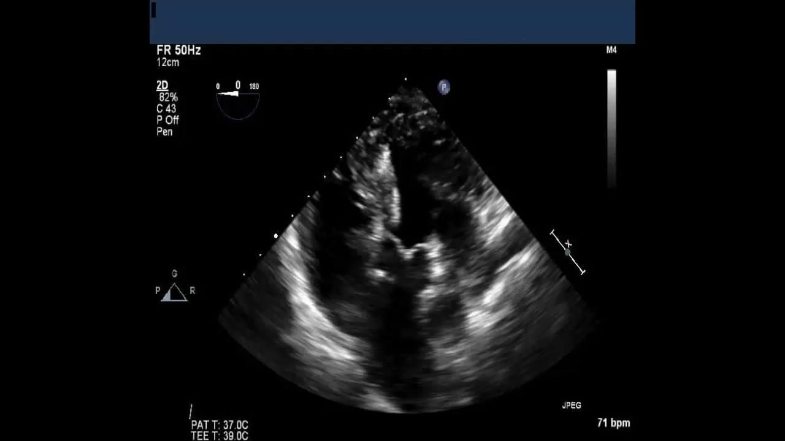
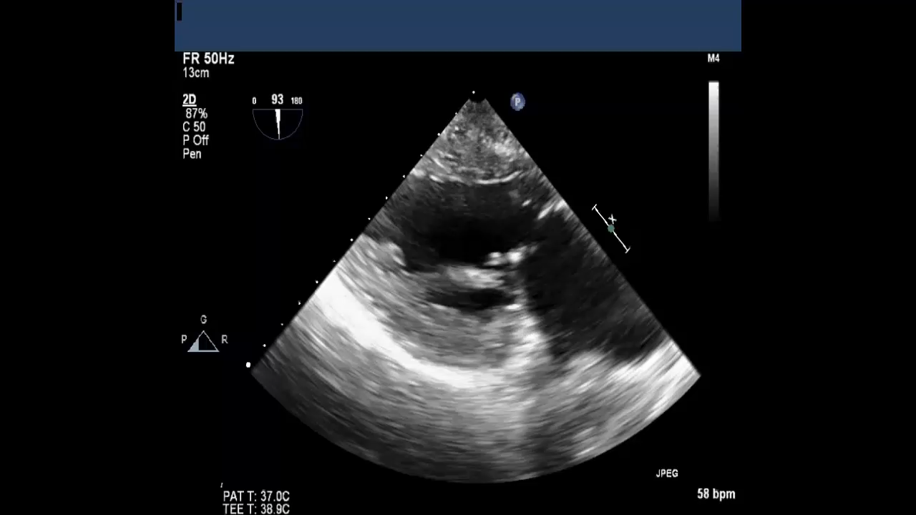
LV
RV
LV
LA
LA
RA
Aorta
LAA
21- Deep TG 5-Chamber View
22- TG 2-Chamber View

Slide 57
24. TG LV LAX View

Slide 58
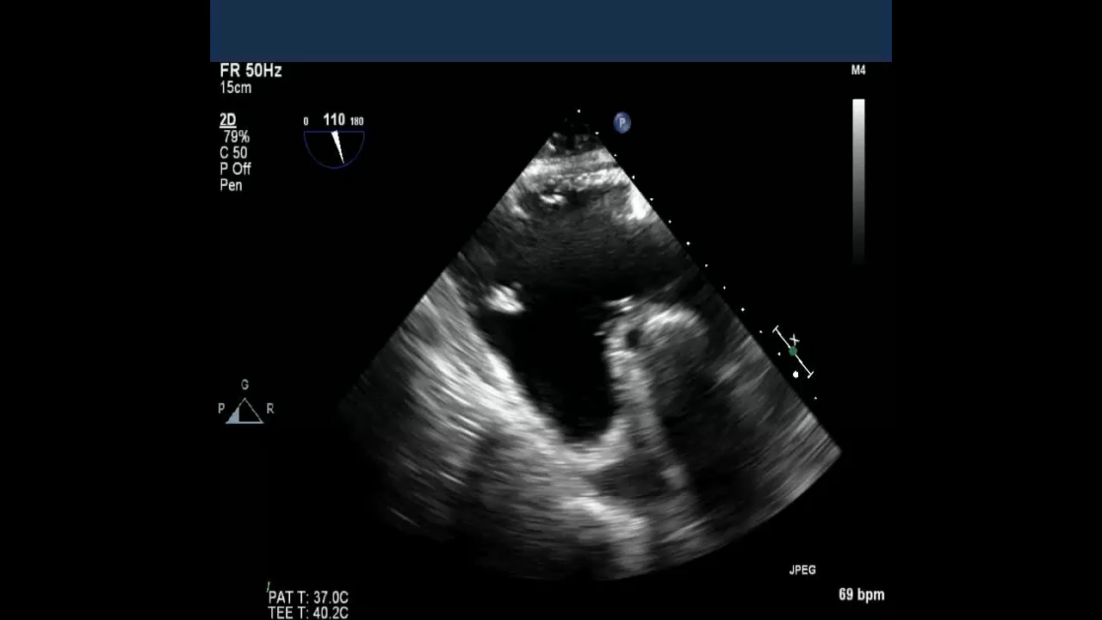
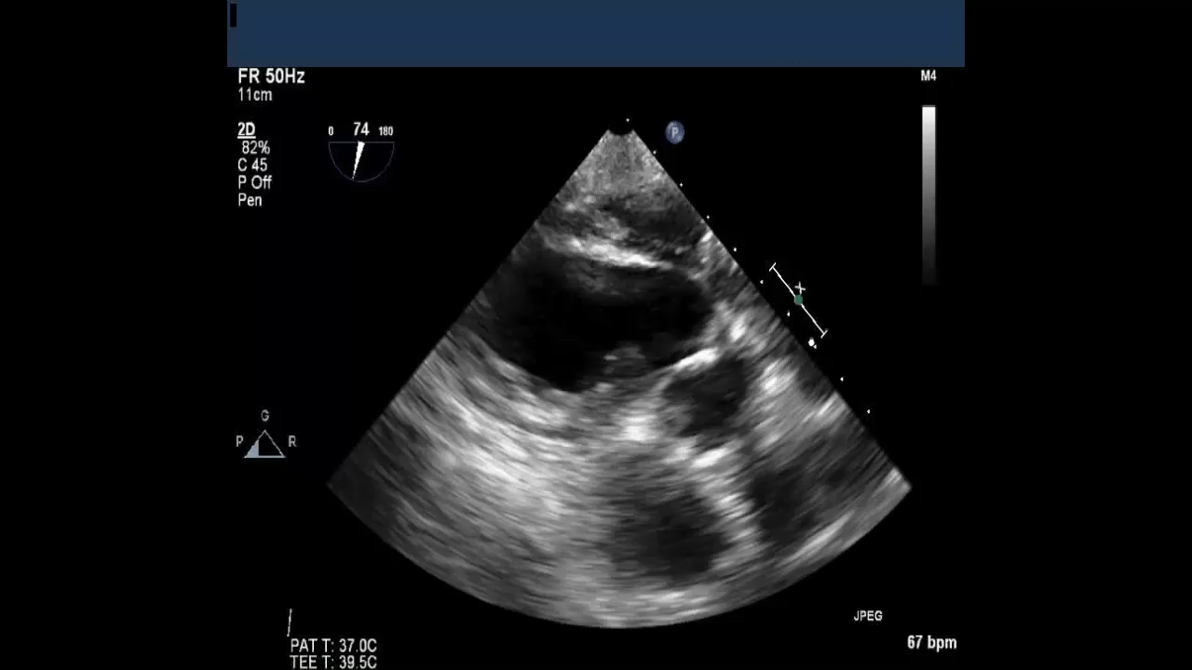
PTVL
RV
RA
LV
LA
LVOT
ATVL
23- TG RV Inflow View
24- TG LAX View

Slide 59
How to assess RV?

Slide 63
Cont.

Slide 66
Case 1
17-year-old boy presented with fatigue and mild cyanosis

Slide 67
Suggested reading materials
Recommendations for cardiac chamber quantification by echocardiography in adults. JASE, 2015.

Slide 68
Questions

Slide 69
Question 1
Which of the following statements about LV anatomy is CORRECT?
LV wall thickness is about 3 times more than RV
LV internal dimensions and volume are larger in women but ejection fraction are more in men
LV apex is the thickest segment in the LV
Endocardial layer of the LV has coarse trabeculation

Slide 70
Question 2
Which of the following statements about function of the LV and RV is CORRECT?
Basal LV rotates in counter-clockwise rotation
LV net twist is the difference between LV apex and base rotation
RV function is more dependent to circumferential contraction of the RV muscle
During systole LV apex moves towards the base to create longitudinal contraction

Slide 71
Question 3
All of the following statements about TEE assessment of LV function are correct EXCEPT
In ME 2-chamber view LV anterior wall and inferior wall can be assessed
In TG SAX view of the LV, the wall below the image is anterior wall
In ME LAX view, LV anterolateral wall can be assessed
TG RV inflow view the best view to measure TAPSE

Slide 72
Question 4
All of the following statements about echocardiographic assessment of LV function are correct EXCEPT
Normal cut off value of LV global longitudinal strain in women is more than men (absolute number)
Normal cut off value of RV global longitudinal strain is more than LV (absolute number)
Normal cut off value of LV EF is less than RV
LV volume in a normal person will decrease in older age

Slide 73
Question 5
Which of the following statements about RV anatomy and function is CORRECT?
In normal person apex of the heart is part of RV
Normal TAPSE is more than 24 mm
Normal RV free wall thickness is about 7-11 mm
Normal E/e’ ratio in RV should be less than 6.0

Slide 74
Correct Answers
1- A
2- B
3- C
4- C
5- D

Slide 75

Thank you.

