Slide 1
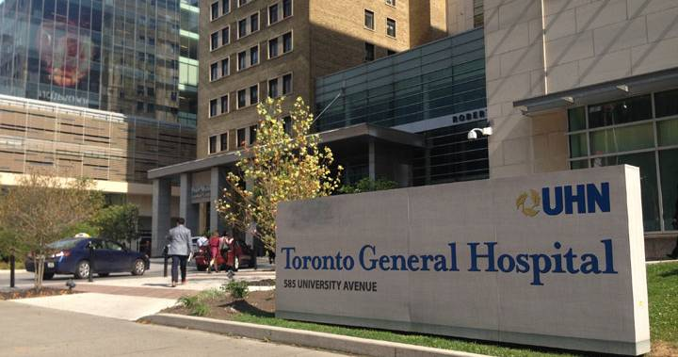


Ahmad S. Omran MD, FACC, FESC, FASE
Consultant Cardiologist
Department of Anesthesia and Pain Management
Toronto General Hospital- UHN
University of Toronto

Slide 2
PTE Mock Exam # 1 Review
(supporting slides)
May 29, 2019
Toronto General Hospital

Slide 3
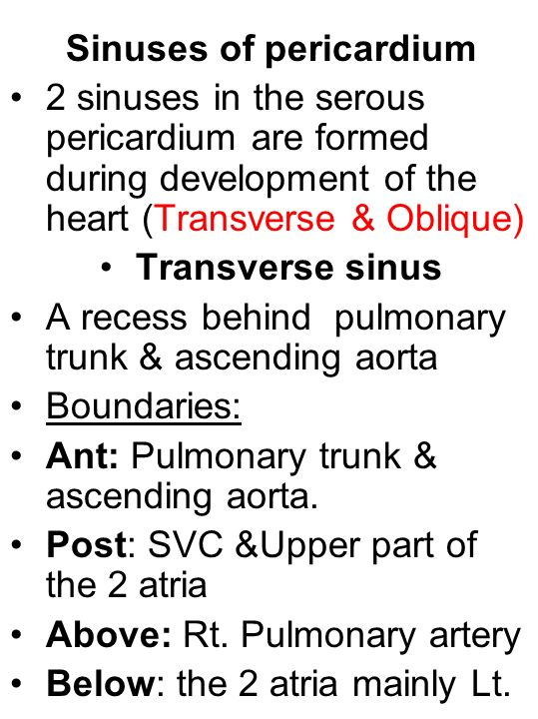
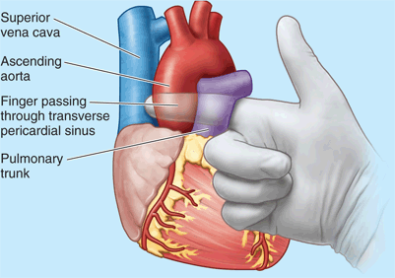
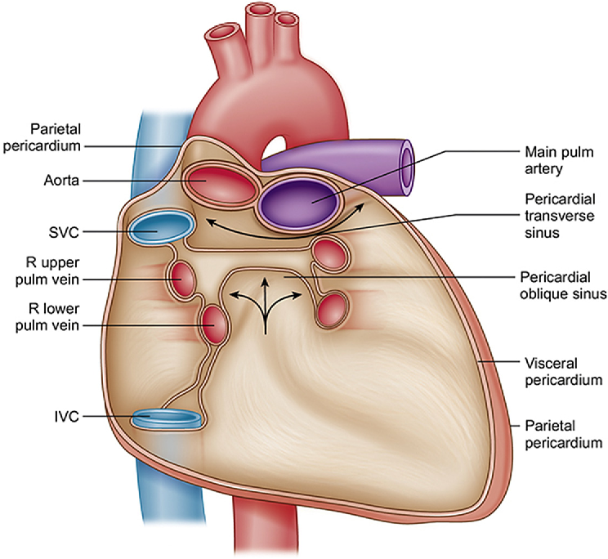
Question 3

Slide 4
Question 4
ASE guidelines, 2015

Slide 5
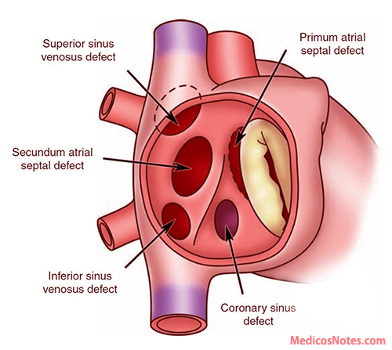
Question 5
(10-15%)
(5%)
(75-80%)
(0.2%)
(1%)
Atrial septal defects

Slide 6
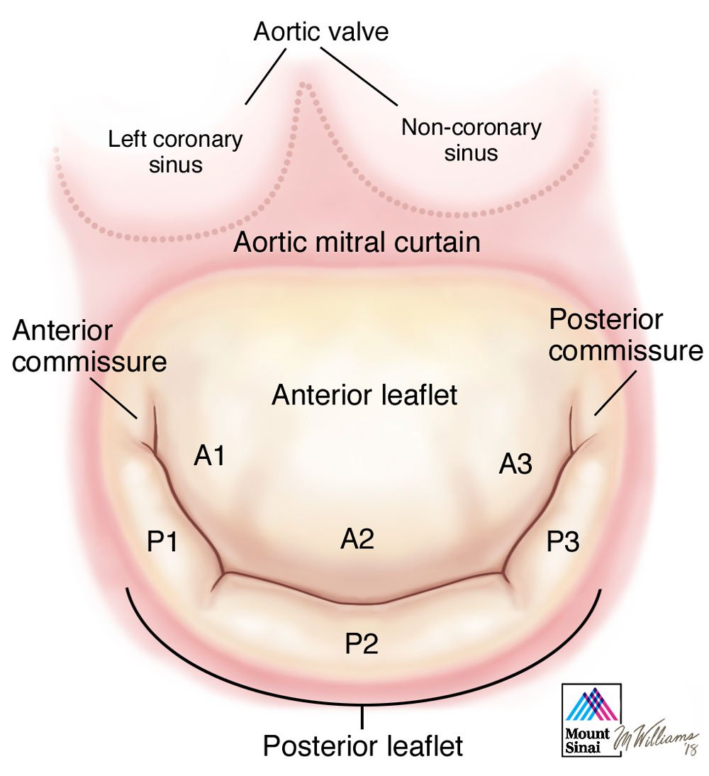
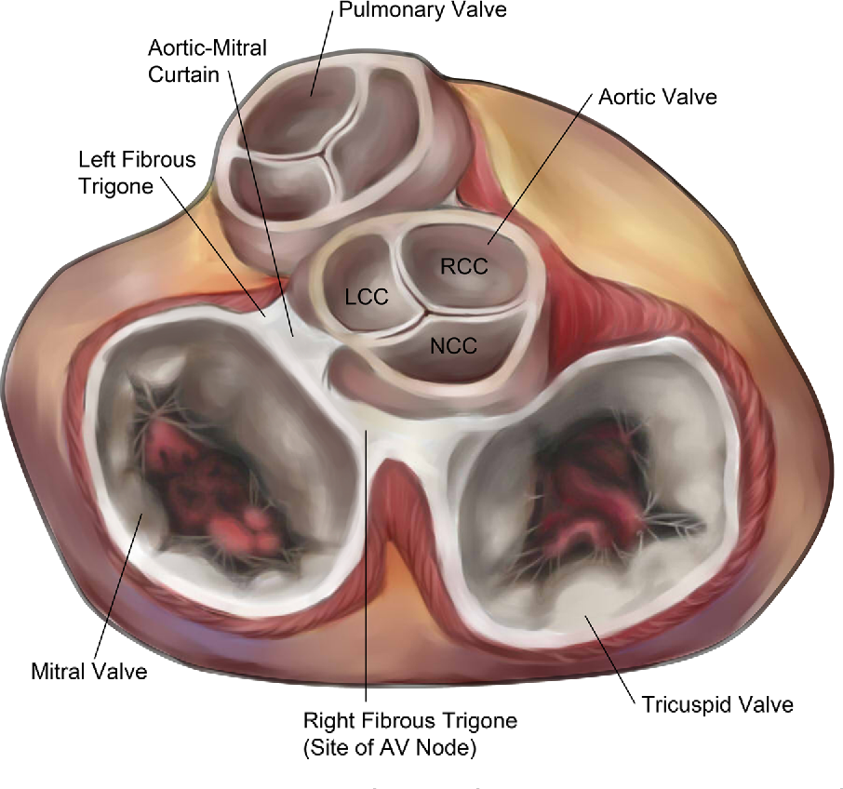
Question 9

Slide 7
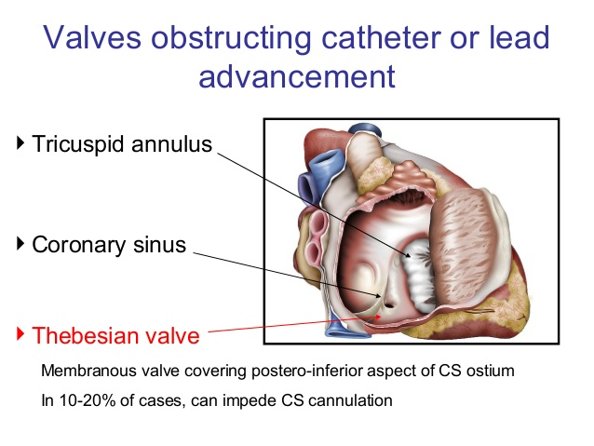
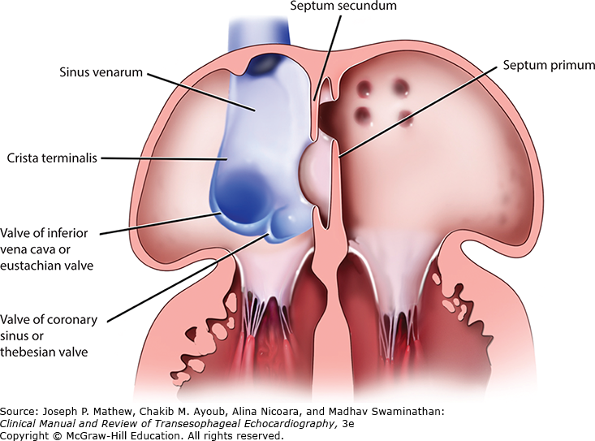
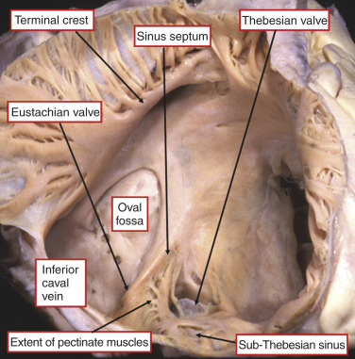
Question 10
Thebesian valve

Slide 8
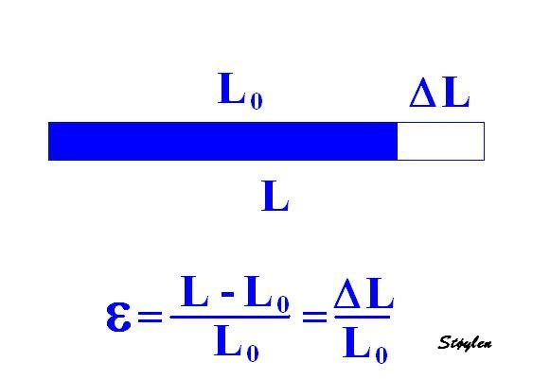
Question 14
Strain, “stretching” means the deformation( unit less)

Slide 9


Strain Rate is the rate by which the deformation occurs, i.e. deformation of strain per time unit. The unit of strain rate is /s or s⁻¹.

Slide 10
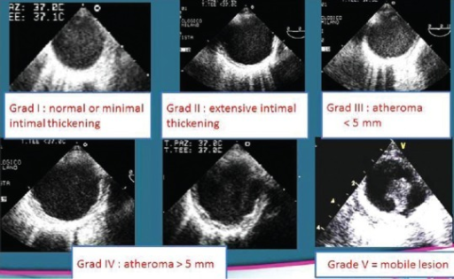
Question 15
Montgomery classification of aortic atheroma

Slide 11
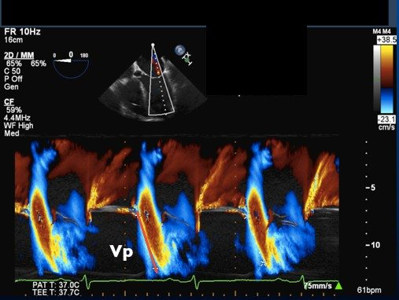
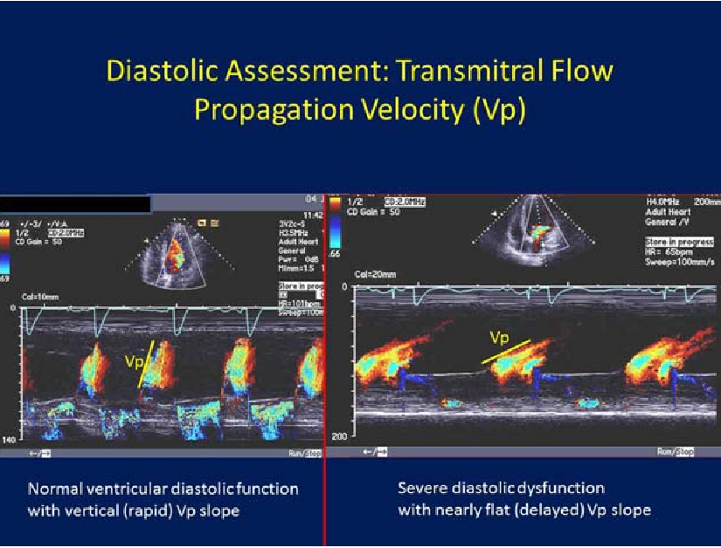
Question 17
Normal > 45 cm/s. Severe diastolic dysfunction < 35 cm/s
Colour M-mode propagation velocity

Slide 12
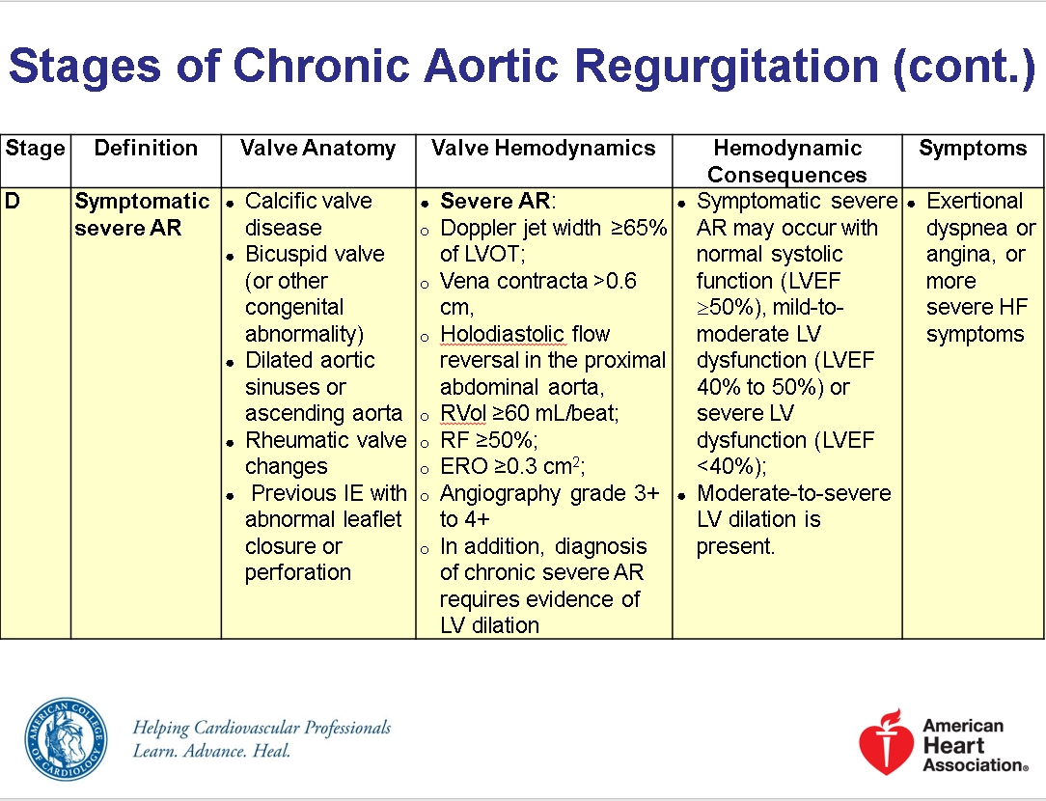
Question 19
ACC/ AHA 2017

Slide 13
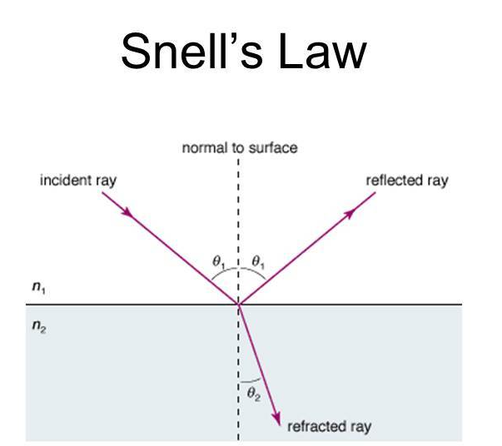
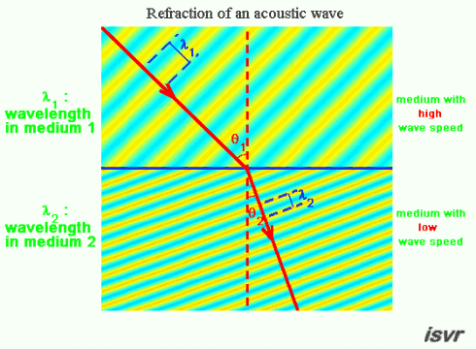
Question 22
Snell’s law in refraction (sound, light and radar)

Slide 14
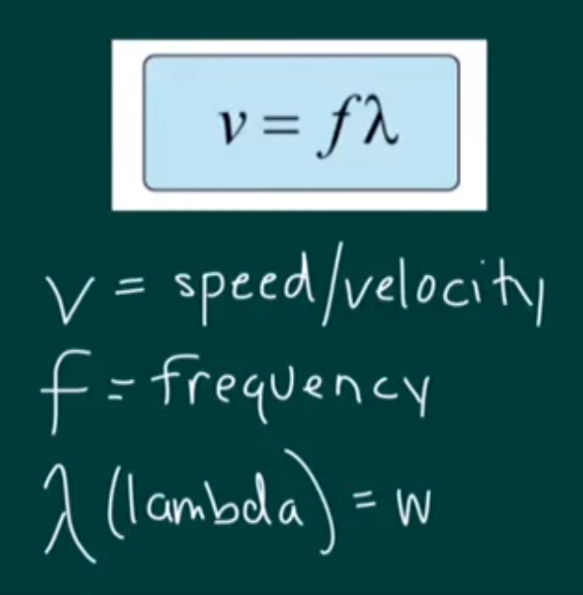
Question 22
Snell’s law in refraction (sound, light and radar)

Slide 15
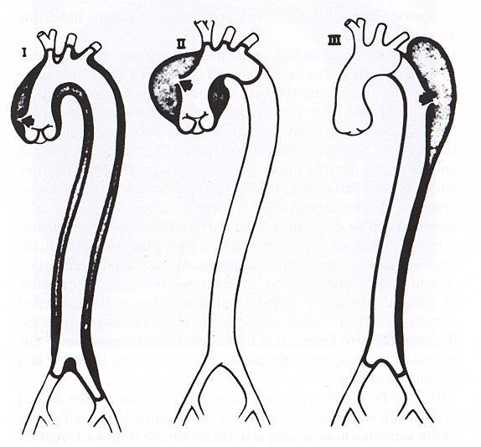
Question 24
De Bakey
Stanford
Type A
Type B

Slide 16
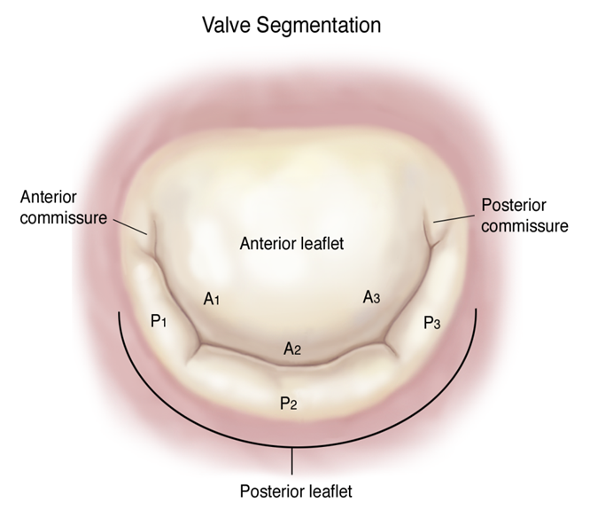
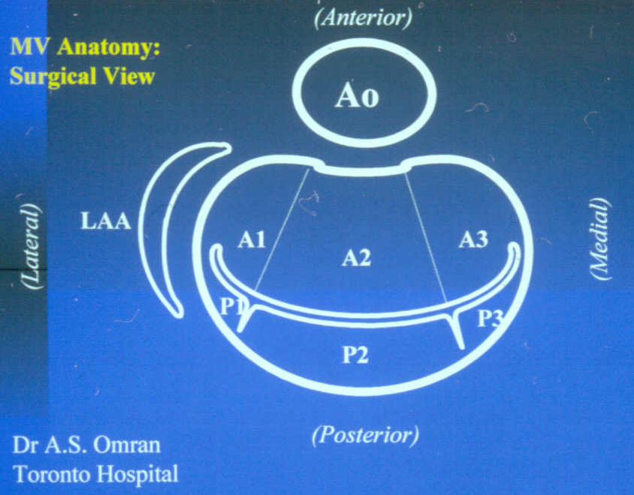
Question 30
1995
Carpentier’s anatomic classification of the MV (segmental classification)

Slide 17
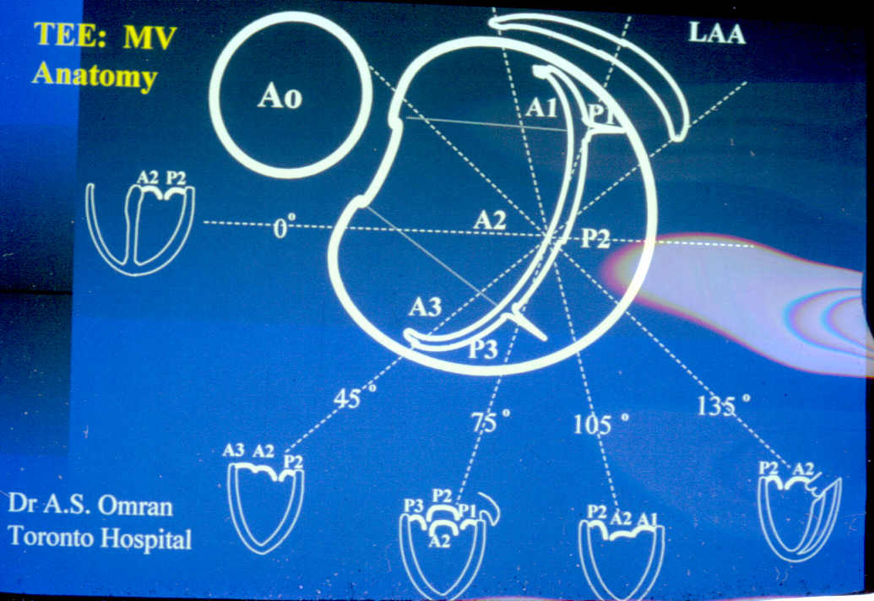
1995
Commissural view

Slide 18
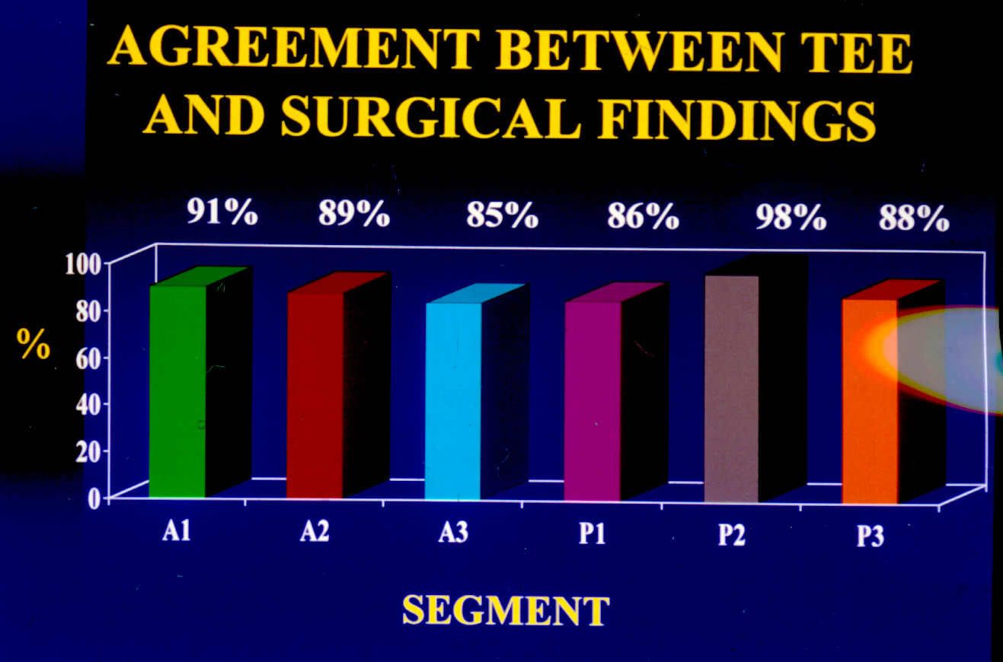

Slide 20
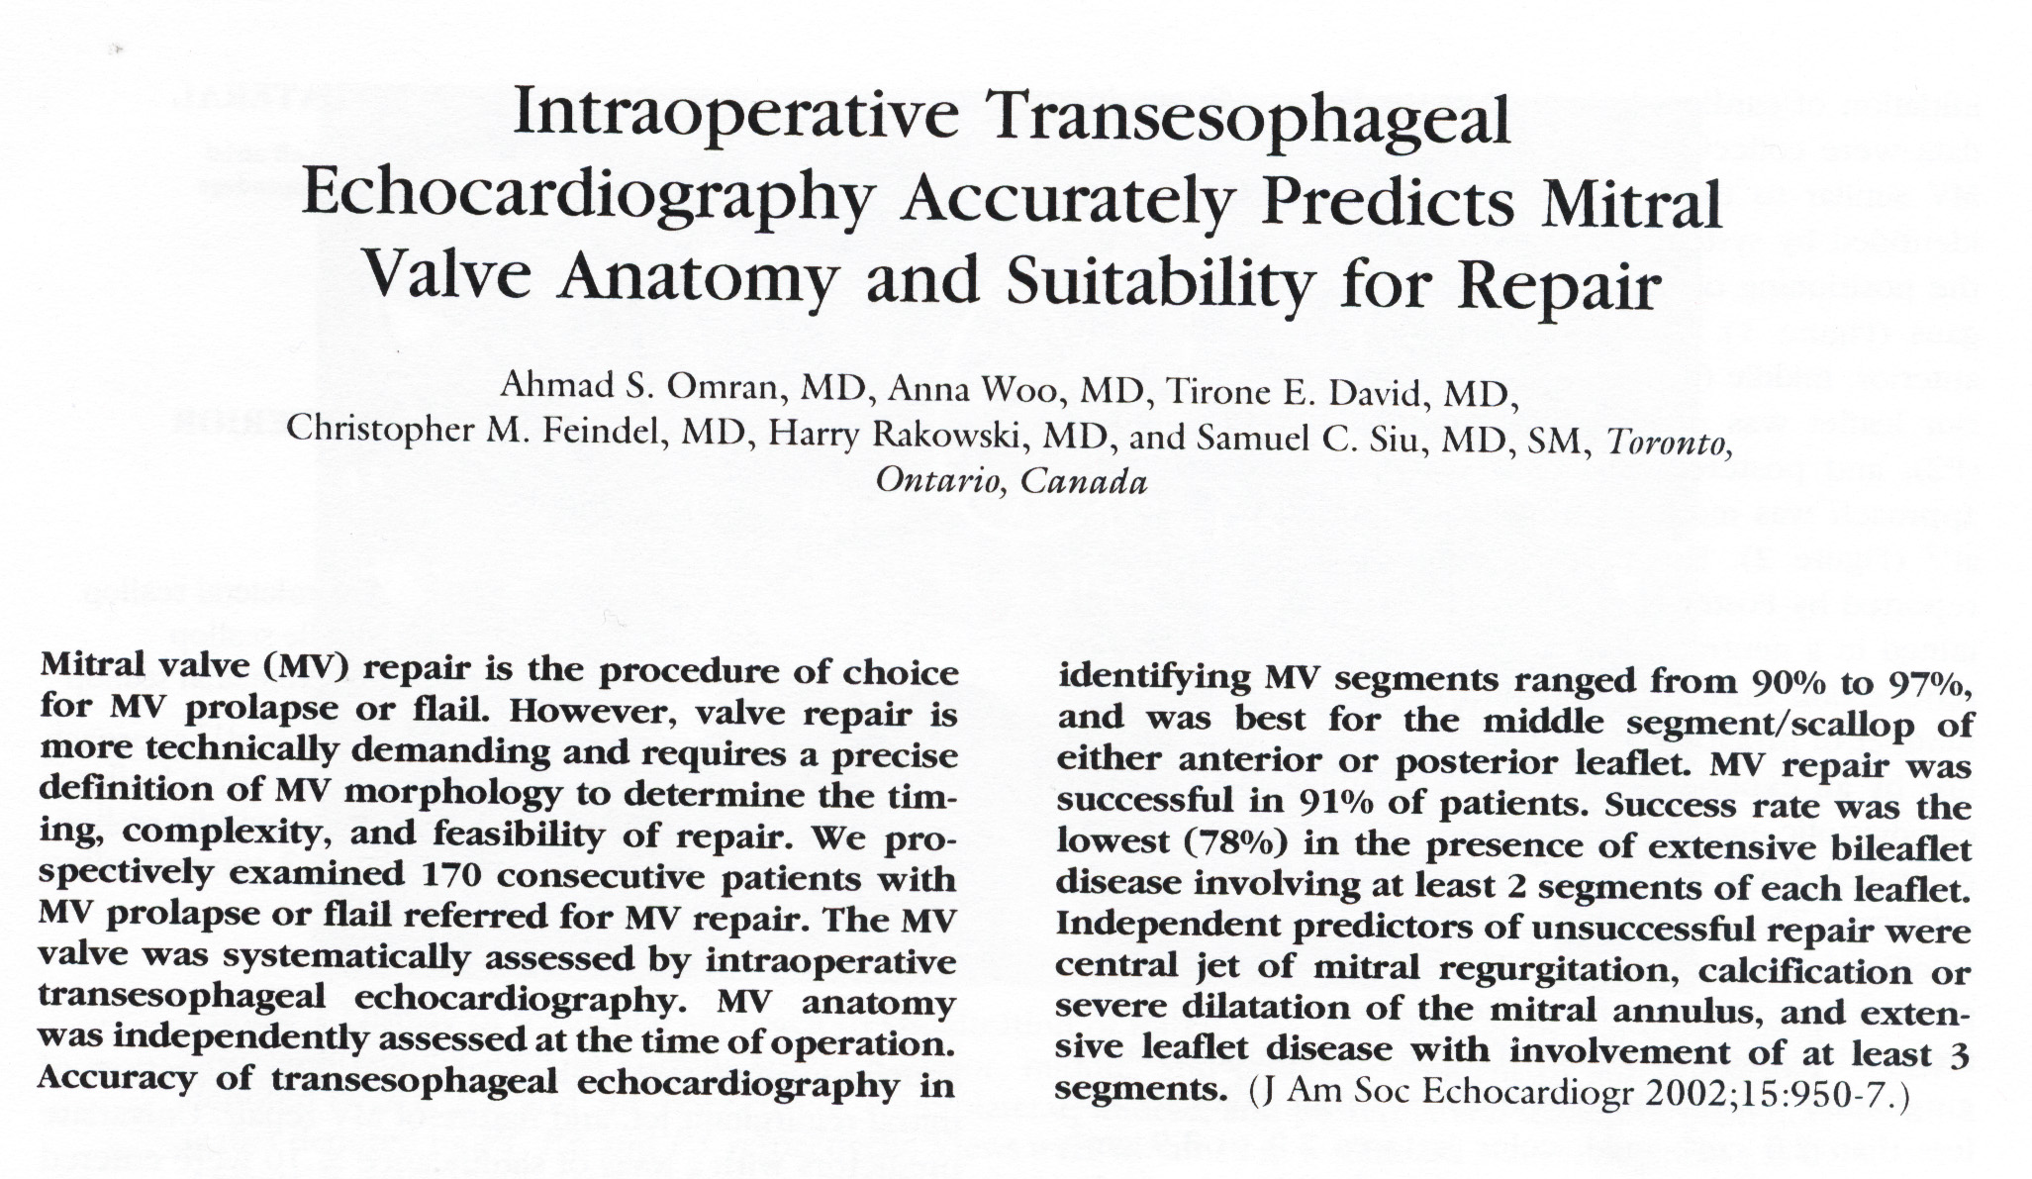

Slide 21
Question 31
2015

Slide 23
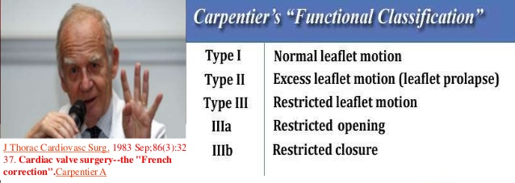
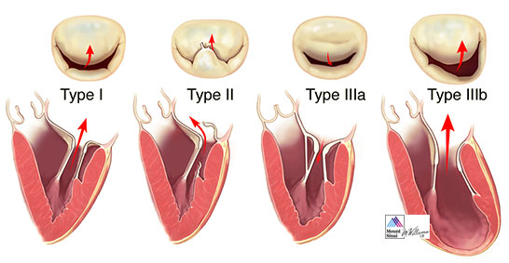
Question 32

Slide 24
Question 39
2016 ASE diastolic function guidelines

Slide 25
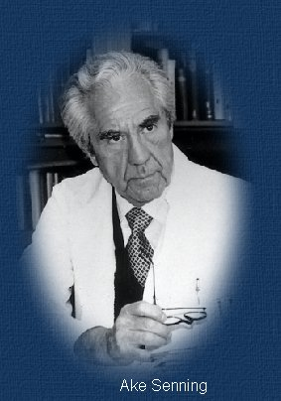
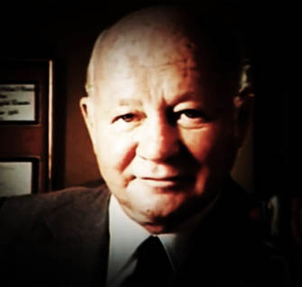
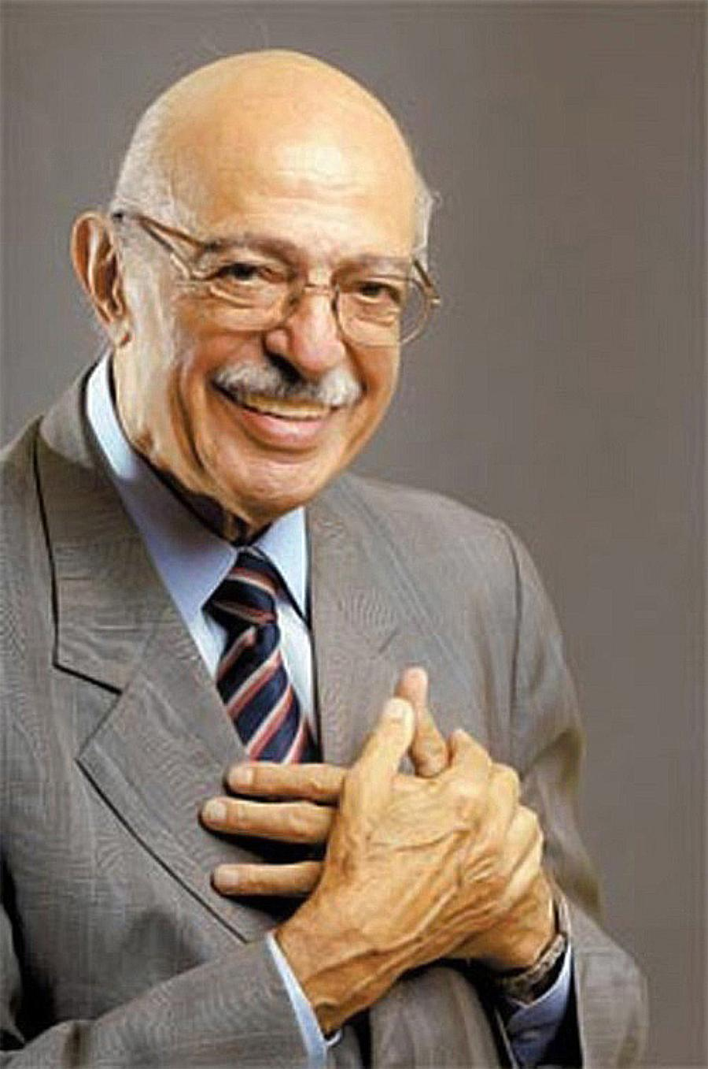
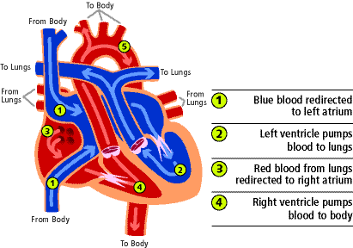
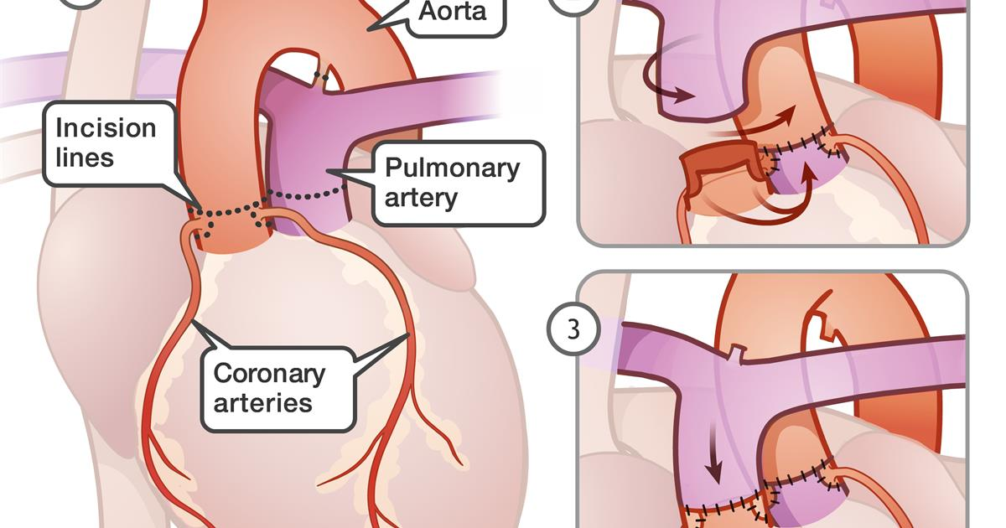
Question 40, 41
Senning
Mustard
Jatene
First atrial switch operation was done in D-TGA by a Swedish cardiac surgeon Ake Senning in 1959 (he implanted the first cardiac pacemaker as well in 1958). In 1962 , Mustard at Sick Kids Hospital, Toronto introduced the new technique for baffling
First arterial switch operation was done by Brazilian surgeon, Adib Jatene in 1975

Slide 26

Thank you.

