Slide 1
Mitral Stenosis
Dr Annette Vegas FRCPC, FASE
Professor Anesthesiology

Slide 2
Outline
Etiology
Physiology
Echocardiography
Valve
Secondary
Assessment
http://pie.med.utoronto.ca/TEE/TEE_content/TEE_assessment_cardiacValves.html
Notes:
Over the course of this lecture we look at ….of MS
Etiology
Physiology
Echocardioraphy
Assessment
Refer to web module at PieMed

Slide 3
Etiology
Rheumatic (75%)
Calcific
Congenital
Parachute MV
Shone complex
Inflammatory
Lupus
Rheumatoid arthritis
Mass
Notes:
Etiology Mitral Stenosis
Mainly rheumatic 75%
Degenerative
Congenital (parachute MV, Shone complex)
Inflammatory (Lupus, RA)
Mass (myxoma) with normal MV leaflets
Cortriatriatum sinister
Carcinoid thickens valve leaflets and does not affect the MV, though is more likely to cause MR
Shone complex: congenital MS and other left-sided inflow/outflow obstructions

Slide 4
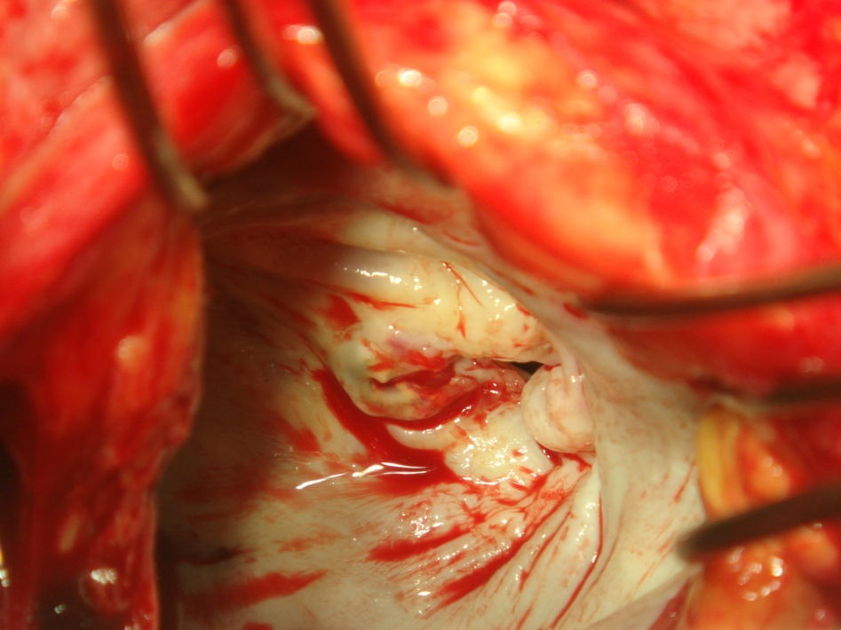
Rheumatic MV
Leaflet thickening + calcification
Commissural fusion
Chordal shortening + fusion = funnel shape
Notes:
Rheumatic
The leaflets become fibrotic and appear thickened.
Commissural fusion is a key distinguishing feature between rheumatic and degenerative MS. It also identifies severe MS as complete fusion of both commissures indicates more advanced disease.
Chordal shortening further impairs leaflet tip mobility creating a funnel shaped valve with a buttonhole ("fish mouth") opening.

Slide 5
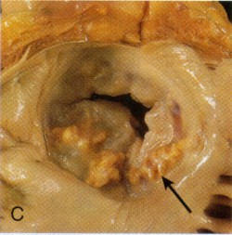
Calcific MV Pathology
Annular calcification
Posterior leaflet
Leaflet base rather then tip
No commissural fusion
Directly involves AV
Notes:
Calcific
Mitral annular calcification (MAC) less often causes MS, in the elderly.
Calcification of the valve annulus, particularly involves the posterior mitral valve leaflet, and may extend onto the leaflets restricting leaflet opening.
There is a lack of commissural fusion.
This pattern of leaflet thickening and restricted motion is opposite to that observed in rheumatic MS.
In calcific aortic stenosis the fibrous membrane between the AV and MV may become calcified restricting the motion of both valves.

Slide 6
Physiology MS
Diastole
LV relaxes, LVP < LAP, MV opens
Normal: rapid =
MS: ↑ LAP
Notes:
Physiology
As diastole begins, the LV relaxes; LV pressure rapidly decreases below LAP opening the MV. The pressure in both chambers quickly equilibrates with a normal MV since the LV readily accommodates the blood volume.
In MS, LAP remains elevated despite the open MV, as the narrowed valve orifice restricts blood flow.

Slide 7
Rheumatic MV 2D TEE
Thickened leaflet (>3mm)
Restricted motion
At tips
Diastolic doming (hockey stick)
Commissural fusion
Notes:
Rheumatic disease produces thick leaflets (> 3mm). The thickening begins at the leaflet tips and extends down the body towards the commissures. Leaflets may be calcified.
Leaflet motion is tethered at the leaflet tips leaving the more mobile body to bow into the LV during diastole creating a characteristic doming appearance or "hockey stick" deformity seen in all the ME views.
Commissures become fused.

Slide 8
Rheumatic MV 2D TEE
Chordae
Thick
Short
Restricted leaflet motion
Notes:
The subvalvular apparatus involves chordal thickening and fusion which shortens the chordae further restricting MV opening. This is best seen in the TG 2C view

Slide 9
Rheumatic MV 3D TEE
Commissural fusion
LA
LV
Notes:
Leaflets are fused at the medial and lateral commissures.
This is best seen using 3D echocardiography from the LA or LV side

Slide 10
Calcific MV 2D TEE
Restricted motion
At base
No diastolic doming
No Commissural fusion
Notes:
Mitral annular calcification (MAC) has calcium deposits around the annulus, particularly along the posterior leaflet, that may extend to the leaflet body, limiting mobility. There is a lot of shadowing from the calcium.
The subvalvular apparatus is often spared.
This pattern of leaflet thickening and restricted motion is opposite to that observed in rheumatic MS.
This is an important surgical distinction, as MV replacement for MAC is technically more challenging compared to rheumatic MS.

Slide 11
Calcific MV 3D TEE
Notes:
Heavily calcified MV shown from the LA using 3D TEE with orthogonal 2D views.
Note restricted MV leaflet motion with small MV orifice during diastole.

Slide 12
Calcified Rheumatic

Slide 13
MS Secondary Changes
Left Atrium
Enlarged
Spontaneous echo contrast (SEC)
Thrombus
MV (MR)
Pulmonary hypertension
RV dilatation
RVSP
Notes:
Secondary changes occur in the heart and involve the LA, LV and the right side of the heart.
Patients with MS also may have LV dysfunction. LV contractility is difficult to assess because ejection can be reduced by impaired LV preload and elevated afterload (low cardiac output–induced vasoconstriction).

Slide 14
Secondary Changes LA
LA
Thrombus
SEC
LV
Notes:
Reduced MV flow pools blood into an enlarged LA. It is difficult to accurately measure LA size and volume using TEE due to the proximity of the LA to the TEE probe. The ME AV SAX view best correlates measures of LA size with transthoracic images.
Stagnant blood in the LA often has small specks of contrast called spontaneous echo contrast (SEC) or "smoke" that may be a precursor of clot formation.
Clots may be present on the LA walls or LA appendage (LAA) particularly in patients with atrial fibrillation and requires exclusion by careful echocardiographic examination.

Slide 15
Secondary Changes MR
Notes:
Depending on the degree of impaired leaflet mobility there is often concomitant MR as shown here in the ME 4C view.
This may confound the assessment of MS severity and often requires the measurement of MVA.

Slide 16
Secondary Changes PAP
PG 60
RVSP 70
TR
IAS shift to R
RV dilatation
TR
Estimate RVSP
↑ PAP
Not measure of MS severity
Does reduce survival
Notes:
Elevated LAP moves the inter-atrial septum to the right and also dilates the pulmonary veins and transmits pressure to the right-sided circulation producing elevated pulmonary artery pressures (PAP), RV dilatation and tricuspid regurgitation (TR).
Estimate the PA systolic pressure from the TR jet.
The degree of pulmonary hypertension is an indicator of the overall hemodynamic consequences of MS and is not a direct measure of MS severity. The presence of severe pulmonary hypertension decreases patient survival.

Slide 17
Secondary Changes

Slide 18
MS Assessment
Notes:
Assessment of MS severity uses color Doppler, spectral Doppler and the measurement of MVA using different techniques.

Slide 19
Severity MS
 | Mild | Moderate | Severe
MVA* (cm²) | > 1.5 | 1 – 1.5 | < 1
Mean PG** (mmHg) | < 5 | 5 - 10 | > 10
PAP** (mmHg) | < 30 | 30 - 50 | > 50
*specific, **supportive Only f HR 60-80 NSR No single value defines severity
Baumgartner H, et al. J Am Soc Echocardiogr 2009;22:1-23
Notes:
Guidelines have established MS severity based on an estimation of mitral valve area (MVA) with supportive findings of the mean pressure gradient (PG) through the MV and systolic PAP.
No single value defines MS severity.

Slide 20
MS Color Doppler
Diastolic flow
Turbulent antegrade
Nyquist 50-60cm/s
Flow acceleration in LA
Notes:
Color Doppler shows turbulent antegrade diastolic flow across the MV from LA to LV in the ME views. Nyquist is between 50-60cm/s.
Proximal flow convergence with aliasing of color is seen in the LA.

Slide 21
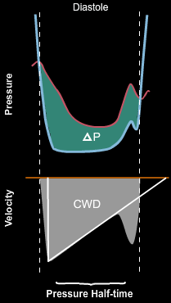
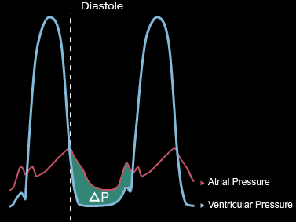
MS Spectral Doppler
Echocardiography does not measure pressure but does measure velocity
MV inflow velocity is directly related to the PG by the Bernoulli equation, record with CWD
PG between LA → LV determines rate of pressure equalization in diastole
Notes:
In a normal heart, as diastole begins the LV relaxes reducing LV pressure below LAP opening the MV thus allowing rapid pressure equilibration between chambers. This is shown by the pressure tracings from the LA and LV.
Echocardiography does not directly measure pressure but does measure velocity.
The mitral valve inflow (MVI) velocity is directly related to the PG by the Bernoulli equation and recorded with continuous wave Doppler (CWD).

Slide 22
MS Spectral Doppler
High E wave velocity
Flattened E wave slope
Fusion E and A wave
PG: mean, peak
MVA: PHT, DT
MR
Higher E velocity
Peak PG > 20mmHg
Mean PG < 10mmHg
Notes:
In MS the narrowed valve orifice restricts blood flow, so LAP remains elevated despite the open MV, increasing the time it takes for LAP and LV pressure to equalize.
The MV inflow spectral profile shows the following changes:
High E wave velocity: increased velocity across valve
Flattened E wave slope: from delayed flow through the valve
Fusion E and A wave: from an absence of diastasis due to the persistently elevated LAP
PG: increased peak and more importantly mean PG
MVA: PHT, DT can be used to calculate the MVA
In combined MV disease with significant MR and MS, the E wave velocity is often high (peak PG > 20mmHg), but the mean PG may be <10mmHg.

Slide 23
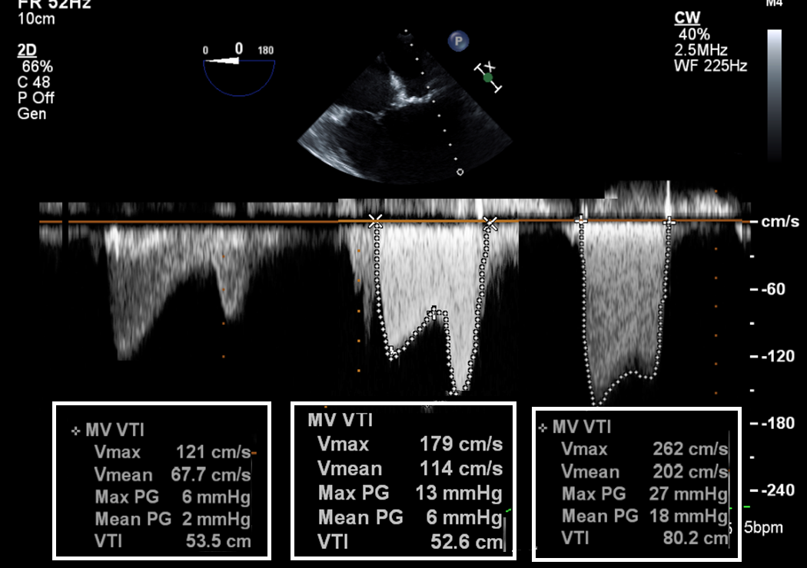
MS Spectral Doppler
Mild Moderate Severe
< 5 5-10 >10
Notes:
Pressure Gradients
Elevation of the mean transmitral PG is the hallmark of MS.
Blood velocity is increased as determined from a spectral Doppler profile using a continuous wave Doppler (CWD) cursor placed through the stenotic MV in ME views.
The peak velocity, mean and peak PG from the modified Bernoulli equation (PG = 4V²) are all increased.
The mean PG obtained by tracing the spectral profile better estimates MS severity and is more prognostic.
Both peak measures are less reliable to quantify MS severity as these are most influenced by LA compliance and LV diastolic function. This is seen best in patients with significant MR and MS, where the E wave velocity is often high (peak gradient > 20mmHg), but the mean pressure gradient may be <10mmHg.

Slide 24
MS PG Limitations
Underestimate MS
(Low PG, Small MVA)
∆ P
Time
Overestimate MS
(High PG, Large MVA)
↓ LAP
↓ HR
ASD
↑ LAP
MR
Diastolic dys
↑ LVEDP
↓ CO
AI
LVH: HBP, AS
Diastolic dys
↓ LVEDP
↑ CO
↑ HR
Notes:
Flow across the MV is variable and determined by the diastolic transvalvular pressure gradient which is influenced by HR, rhythm, LA compliance, LV diastolic function and cardiac output.
In AF use an average of 5 cycles with the least variation of R-R interval and as close possible to normal HR.
A low PG underestimates MS and can be related to: low LAP (bradycardia, ASD) or increased LVEDP (low CO, AI, LVH; diastolic dysfunction)
A high PG overestimates MS and can be related to: high LAP (MR, diastolic dysfunction) or low LVEDP (increased CO, tachycardia).
Use mitral valve area (MVA) to assess MS severity if Doppler gradients are unreliable.

Slide 25
MVA
Anatomic
Planimetry | 2D TG Basal SAX, 3D
Functional
Pressure Half Time | 220 ÷ PHT (ms)
Deceleration Time | 759 ÷ deceleration time (ms)
Continuity Equation | π r² x VTI_{LVOT} VTI_{mitral}
PISA | 2πr² x Valiasing x α /180 Peak Vmitral
Notes:
Many factors influence Doppler pressure gradients often making them unreliable, instead use MVA to assess MS severity.
There are several methods available to determine MVA including planimetry, pressure half time (PHT, P1/2t), continuity or PISA each with advantages and disadvantages.
Planimetry measures the anatomic MVA which is slightly larger than the functional MVA obtained by Doppler methods.
It is best to use several techniques for confirmation of disease and severity.

Slide 26
MVA Limitations
MVA | Avoid in | Use in
Planimetry | Heavily calcified
PHT | AI, LV dysfunction, ASD, diastolic dysfunction | MR, AF
Continuity Equation | AI, LVOT obstruct, MR, AF, intracardiac shunt | Calcific MS
PISA |  | AI, MR, prosthetic, AF
Notes:
This key table summarizes the limitations for the different techniques used to measure MVA.
Each will be discussed individually in the next slides.

Slide 27
MS with Multivalve Lesions
Lesion | PG | MVA
MR | High peak PG, use mean | Underestimate MVA by continuity and PHT
AI | Low flow/PG | Overestimate MVA Continuity (↑ AV flow) ↓ PHT (from ↑ LVEDP)
AS | Low flow/ PG | Overestimate MVA, prolong PHT from impaired LV relax
TR |  | Gorlin formula invalid
Notes:
Important concomitant valve lesions influence the PG across the MV so the presence of significant aortic valve disease and MR requires determination of MVA. Depending on how MVA is measured
Can use different techniques, though PISA will work for all the listed valve lesions

Slide 28
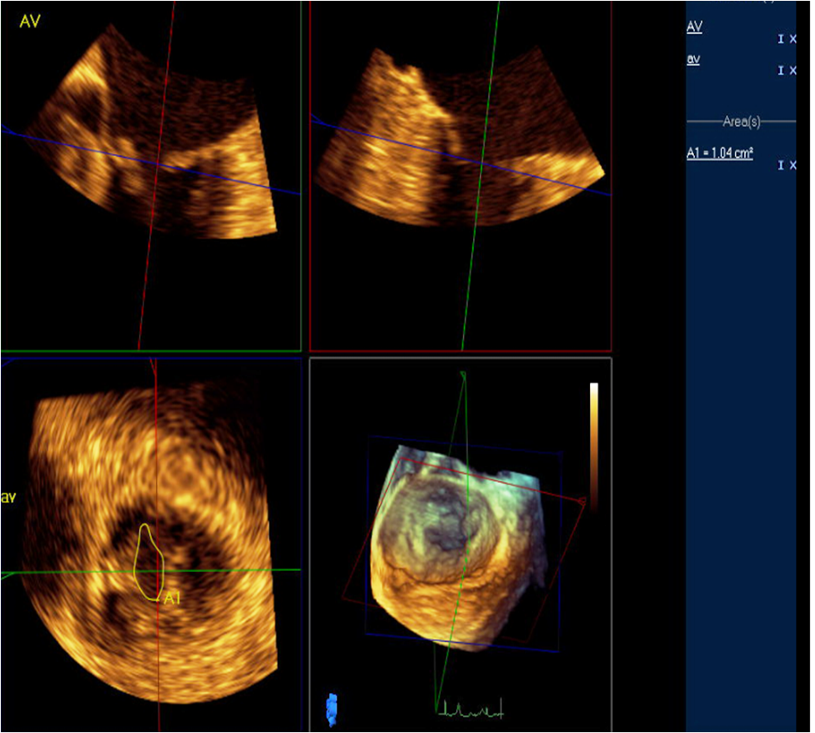
MS MV Area Planimetry
Anatomic measure
Trace open MV orifice in mid-diastole
Identify leaflet tips
Repeat measures in AF
Unreliable in calcific MS due to shadowing
Underestimate ↑HR
MVA 1.04cm²
Notes:
Tracing the inner edge of the MV orifice during mid-diastole from the TTE parasternal SAX view is the “gold” standard for determining the anatomic MVA. This technique correlates well with invasively derived measures and orifice size in explanted valves.
In a similar way, MVA planimetry uses the TEE TG basal SAX view.
3D TEE aligns planes through the smallest orifice to trace the MVA.
Planimetry is often limited by poor quality images, oblique cuts and excessive 2D gain (overestimate smaller MVA). Since the stenotic MV forms a funnel shape moving the imaging plane back and forth determines the narrowest valve area.
Extensive calcifications can obscure identification of the exact location of the MV edge.

Slide 29
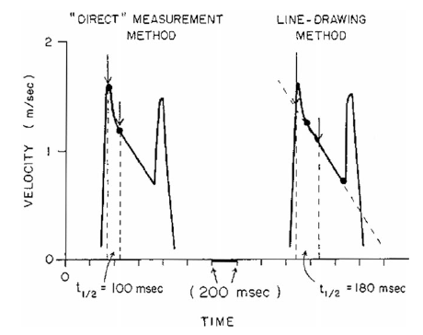
MS MVA Pressure Half-Time
Time (in ms) from peak MV to half initial value
MVA = 220/PHT
Normal
Post BMV
Post Prosthetic
If bimodal use mid part
Deceleration time
Time from peak to 0
PHT = 0.29DT
MVA = 759/DT
Notes:
PHT uses the rate of pressure drop across the MV to calculate MVA.
PHT is the time it takes for the peak transmitral pressure gradient to decrease by half. The more stenotic, the longer it takes for the LV to fill hence prolonging the PHT.
In MS, calculate the MVA (in cm²) from the empirically derived formula: MVA = 220/PHT. This formula is not validated for a normal native MV, after balloon valvuloplasty or with a newly implanted prosthetic valve.
The Deceleration Time (DT) is the time from peak to zero velocity and is related to PHT by: PHT = 0.29DT. Calculate the MVA from the formula: MVA = 759/DT.

Slide 30
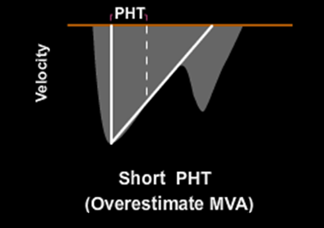
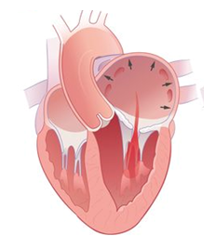
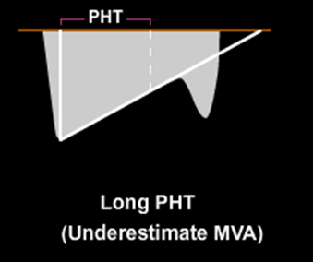
MS MVA PHT Limitations
↑ LVEDP/ ↓ compliance
AI
Cardiomyopathy/LVH
Diastolic dysfxn (aging)
↓ LAP compliance
ASD
MR
AF, ↑ HR
Large LA
Abnormal relaxation
Avoid PHT in
Elderly
Calcific
Diastolic dysfunction
? Post CPB, BMV
Notes:
Depends on LA compliance and LV diastolic compliance
Increased LVEDP (decreased compliance) from AI, cardiomyopathy, LVH (AS, hypertension) or diastolic dysfunction (restrictive) shortens the PHT giving a smaller MVA then actually exists (overestimates MVA).
In a similar way altered LA compliance from ASD, MR, AF or tachycardia will shorten the PHT giving a smaller MVA then actually exists (overestimates MVA).
PHT measurements rely on pressure differences and flow through the valve. A prolonged PHT does not necessarily indicate MS. Patients with abnormal myocardial relaxation have a prolonged PHT, but the peak E velocity is not increased and is usually <1 m/sec.
Diastolic changes in the elderly make PHT less reliable particularly for MVA in calcific MS.
PHT has not been validated in the post CPB patients and has been found inaccurate in post-commissurotomy patients due to its dependence on net chamber compliance.

Slide 31
MVA PHT
MV mean PG 5mmHg, MVA 1.11cm²
Notes:
Shown here is calcific MS with color Doppler and Spectral Doppler trace showing a mean gradient of 5 mmHg and MVA by PHT of 1.11cm².

Slide 32
MS MVA Continuity
Avoid if
AI (overestimate),
MR (underestimate)
ASD
AF
Notes:
Continuity Method
Continuity equation uses conservation of mass to calculate MVA of the diseased MV by comparing flow across a normal AV. There should be no AV pathology, LVOT obstruction, MR or atrial fibrillation.
A limitation to the continuity method is the need to use multiple measurements.
It is reliable in calcific MS (as compared with PHT).

Slide 33
MVA Continuity
Notes:
Continuity Method
Calculate stroke volume (SV) thru the AV from measurements of the AV diameter (ME AV LAX view) and the AV VTI (TG view), as shown here.
Obtain a spectral Doppler trace with good alignment to forward flow in the deep TG view.
The AV annulus measured in systole was 1.7cm.
In this case the AV SV calculates as 56cc (show measurement).
Divide the stroke volume by the MV VTI to obtain a MVA of 1.21 cm² compared with 1.11cm² by the PHT method.
Despite the ugly looking valve, the mean pressure (5mmHg) and MVA of > 1cm² suggests moderate MS.

Slide 34
MVA PISA
Notes:
PISA method calculates mitral flow during diastole based on the hemispheric shape of the convergence zone in the LA seen with color Doppler. MVA is calculated by dividing the mitral volume flow by the maximum velocity of mitral flow.
This is a less validated method to estimate MVA, but is useful in the presence of AI, MR, prosthetic valve or arrhythmia. It is unaffected by LA and LV compliance.
This method assumes spherical flow convergence area, though the geometry of isovelocity shells changes with flow rate, pressure gradients, orifice size and shape.

Slide 35
MVA PISA
Notes:
The technique uses a zoomed view of the CFD convergence region.
Alter the color scale by reducing the overall scale (30-45cm/s) or shifting the baseline downwards which increases the hemisphere radius. The aliasing velocity at the bottom of the color scale is noted in cm/s (should be smaller of 2 velocities).
Take a measurement (in cm) of the hemisphere radius (r) from the aliased region to the valve orifice.
Calculate flow through the MV from the formula. Measure the peak MV velocity (Vmax) by CW Doppler.

Slide 36
MVA PISA
Notes:
Measure the correction angle (α) if the hemisphere is < 180°.
Calculate flow through the MV from the formula.
Measure the peak MV inflow velocity (Vmax) by CW Doppler.
Here the angle correction is 100° (or 100/180)
Given the following: PISA r 1.0cm, Va 38.5cm/s, angle 100, MV VTI 155cm/s
The MVA calculates to be 0.95cm²

Slide 37
MV Interventions in MS
Class | 2014 AHA/ACC Guidelines MV Interventions in MS | Level of Evidence
I | PBC for symptomatic patients, severe MS (MVA ≤1.5 cm2, stage D) and favorable valve morphology without LA thrombus or moderate-to-severe MR | A
 | MV surgery (repair, commissurotomy, or valve replacement) for severely symptomatic patients (NYHA class III to IV), severe MS (MVA ≤1.5 cm2, stage D), not high risk for surgery or not candidates or failed PBC | B
 | Concomitant MV surgery for severe MS (MVA ≤1.5 cm2, stage C or D) undergoing other cardiac surgery | C
IIa | PBC reasonable asymptomatic very severe MS (MVA ≤1.0 cm2, stage C) and favorable valve morphology without LA thrombus or moderate-to-severe MR | C
 | MV surgery reasonable severely symptomatic (NYHA class III to IV), severe MS (MVA ≤1.5 cm2, stage D), with other operative indications | C
IIb | PBC consider asymptomatic, severe MS (MVA ≤1.5 cm2, stage C) favorable valve morphology without LA thrombus or moderate-to-severe MR with new onset of AF | C
 | PBC consider symptomatic MVA > 1.5 cm2 with hemodynamically significant MS based on PCWP > 25 mm Hg or mean MV gradient > 15 mm Hg during exercise. | C
 | PBC consider severely symptomatic (NYHA class III to IV), severe MS (MVA ≤1.5 cm2, stage D), suboptimal valve anatomy and not candidates/high risk for surgery | C
 | Concomitant MV surgery consider moderate MS (MVA 1.6 – 2.0 cm2) undergoing other cardiac surgery | C
 | MV surgery + LAA excision consider for severe MS (MVA ≤1.5 cm2, stages C and D) with recurrent embolic events despite adequate anticoagulation. | C
Notes:
MV interventions include percutaneous balloon mitral valvuloplasty (BMV) and surgical repair or replacement.
BMV is non-surgical option in symptomatic patients with MS. A balloon inflated across the MV fractures the commissures improving leaflet mobility and MVA. Studies show good short and long-term results with minimal complications.
Indications are as listed from the 2014 AHA guidelines.

Slide 38
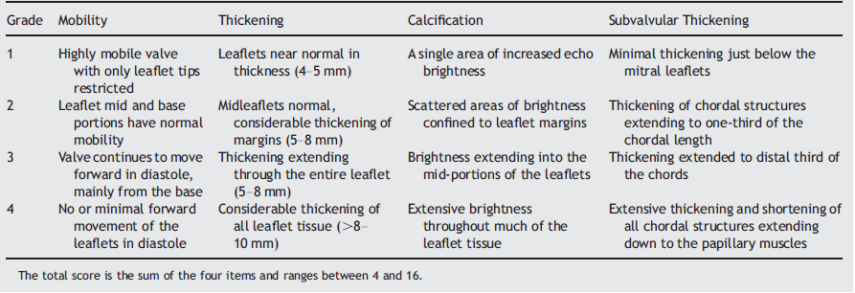
MS Management Wilkins Score
Based on valve morphology
Low score ≤ 8, good outcome
Wilkins, GT, et al. Percutaneous balloon dilatation of the mitral valve: an analysis of echocardiographic variables related to outcome and the mechanism of dilatation. Br Heart J, 1988 60(4), 299-308.
Notes:
Based on an echocardiographic assessment of leaflet mobility, thickening, calcification and subvalvular thickening ranked on a scale of 1-4.
Initially used for grading of outcome after balloon valvuloplasty
Low score ≤ 8, good outcome

Slide 39
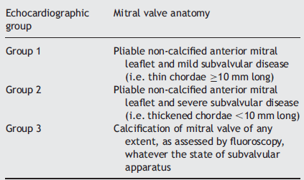
MS Management Cormier Score
Based on leaflet calcification and subvalvular
√
√
X
Iung, B, Cormier, B, et al. (1996). Immediate results of percutaneous mitral commissurotomy. A predictive model on a series of 1514 patients. Circulation 1996, 94(9), 2124-2130.
Notes:
Cormier Score
Divides the patients into 3 groups based on leaflet mobility and calcification as well as the subvalvular apparatus
Group 3 morphology is unfavourable for BMV

Slide 40
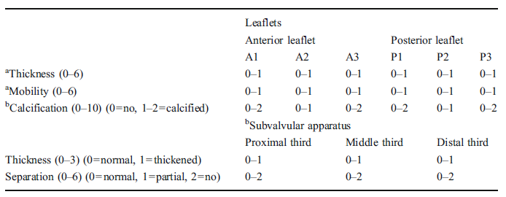
MS Management 3D TEE Score
Divides leaflets into 3 portions, scores each
Mild | Moderate | Severe
<8 | 8 - 13 | ≥14
Soliman O I, et al. New Scores for the Assessment of Mitral Stenosis Using Real-Time Three-Dimensional Echocardiography. Curr Cardiovasc Imaging Rep 2011, 4(5), 370-377.
Notes:
3D TTE Score
Selective to optimize outcome of BMV
Scoring of both MV leaflets and subvavlular apparatus
Each leaflet was divided into 3 segments which were individually scored for thickness, mobility and calcification.
The subvalvular apparatus was scored at 3 levels; proximal, mid and distal
Total score out of 31, with mild < 8, moderate 8-13, severe ≥ 14

Slide 41
Selected Readings
Cherry AD, Maxwell CD, Nicoara A. Intraoperative Evaluation of Mitral Stenosis by Transesophageal Echocardiography. Anesth Analg 2016;123:14-20.
Baumgartner H, et al. Echocardiographic assessment of valve stenosis: EAE/ASE recommendations for clinical practice. J Am Soc Echocardiogr 2009;22:1-23.
Wunderlich NC, Beigel R, Siegel RJ. Management of Mitral Stenosis Using 2D and 3D Echo-Doppler Imaging. JACC: Cardiovasc Imaging 2013;6:1191-1205.
Alaa Mabrouk SO, Tanaka H, et al. Comparison of mitral valve area by pressure half-time and proximal isovelocity surface area method in patients with mitral stenosis: effect of net atrioventricular compliance. Eur J Echocardiogr 2011;12:283–290.
Wilkins, GT, et al. Percutaneous balloon dilatation of the mitral valve: an analysis of echocardiographic variables related to outcome and the mechanism of dilatation. Br Heart J, 1988 60(4), 299-308.
Iung, B, Cormier, B, et al. (1996). Immediate results of percutaneous mitral commissurotomy. A predictive model on a series of 1514 patients. Circulation 1996, 94(9), 2124-2130.
Soliman O I, et al. New Scores for the Assessment of Mitral Stenosis Using Real-Time Three-Dimensional Echocardiography. Curr Cardiovasc Imaging Rep 2011, 4(5), 370-377.
Notes:
Cherry AD, Maxwell CD, Nicoara A. Intraoperative Evaluation of Mitral Stenosis by Transesophageal Echocardiography. Anesth Analg 2016;123:14-20.
Baumgartner H, et al. Echocardiographic assessment of valve stenosis: EAE/ASE recommendations for clinical practice. J Am Soc Echocardiogr 2009;22:1-23.
Wunderlich NC, Beigel R, Siegel RJ. Management of Mitral Stenosis Using 2D and 3D Echo-Doppler Imaging. JACC: Cardiovasc Imaging 2013;6:1191-1205.
Alaa Mabrouk SO, Tanaka H, et al. Comparison of mitral valve area by pressure half-time and proximal isovelocity surface area method in patients with mitral stenosis: effect of net atrioventricular compliance. Eur J Echocardiogr 2011;12:283–290.
Wilkins, GT, et al. Percutaneous balloon dilatation of the mitral valve: an analysis of echocardiographic variables related to outcome and the mechanism of dilatation. Br Heart J, 1988 60(4), 299-308.
Iung, B, Cormier, B, et al. (1996). Immediate results of percutaneous mitral commissurotomy. A predictive model on a series of 1514 patients. Circulation 1996, 94(9), 2124-2130.
Soliman O I, et al. New Scores for the Assessment of Mitral Stenosis Using Real-Time Three-Dimensional Echocardiography. Curr Cardiovasc Imaging Rep 2011, 4(5), 370-377.

Slide 42
Question 1
Which of the following is not a finding in rheumatic MS ?
Commissural fusion
Annular + leaflet base calcification
Chordal shortening + fusion
Leaflet tip calcification
Diastolic doming
Notes:
Correct answer B

Slide 43
Question 2
What is the calculated MVA ?
0.72
0.92
1.08
1.20
1.40
P1/2t 239ms
Notes:
Correct answer B
220/239 = 0.92

Slide 44
Question 3
Which of the following is true ?
Mean gradient is underestimated with tachycardia
MR underestimates MS severity by mean PG
Pressure half time is decreased with reduced cardiac output
AI overestimates MVA by PHT method
Notes:
Correct answer E

Slide 45
Question 4
Severe MV stenosis is diagnosed when the normal MVA is reduced by at least ?
25%
33%
50%
66%
75%

Slide 46
Question 5
Which secondary finding is not consistent with the isolated MS ?
Dilated left atrium
Dilated right ventricle
Dilated left ventricle
Dilated tricuspid valve annulus

Slide 47
Question 6
What is the calculated MVA (in cm²) based on the information provided:
r 1.7cm, Valias 25cm/s, Vmax 250cm/s, α angle 100
0.8
1.0
1.2
1.4
MVA = 2πr² x Va/Vmax x α/180
= 2(3.14) (1.7)² x (25/250) x 100/180
= 1.0
Notes:
Correct answer 1.0

